Slide 1
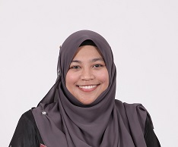
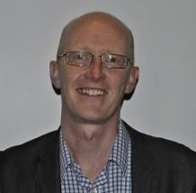
Summary of the day and plans for tomorrow
Emilia Zainal Abidin
Associate Professor
Department of Environmental and Occupational Health
Faculty of Medicine and Health Sciences
Universiti Putra Malaysia
za_emilia@upm.edu.my
Sean Semple
Associate Professor
Institute for Social Marketing
Faculty of Health Sciences and Sport
University of Stirling
sean.semple@stir.ac.uk

Slide 2
So what did we learn?
UK not the same as Malaysia – need to be culturally sensitive
Malaysia nearly half of all men smoke; almost no women smoke
This impacts on how we approach education, health promotion, mass media and changing social norms
Directly to men but also – empower women to enforce smoke-free homes
Political will in Malaysia – more work needed
Need to be positive and upbeat about protection of children’s health
Don’t lecture or be negative about smokers’ behaviour
Use ALL existing health services to promote the SFH message
Integrate SFH/SHS effects in curriculum
Children are a good means of communicating the message about SFH
Using air quality feedback may have a role – especially linking to environmental information about ‘haze’ events

Slide 3
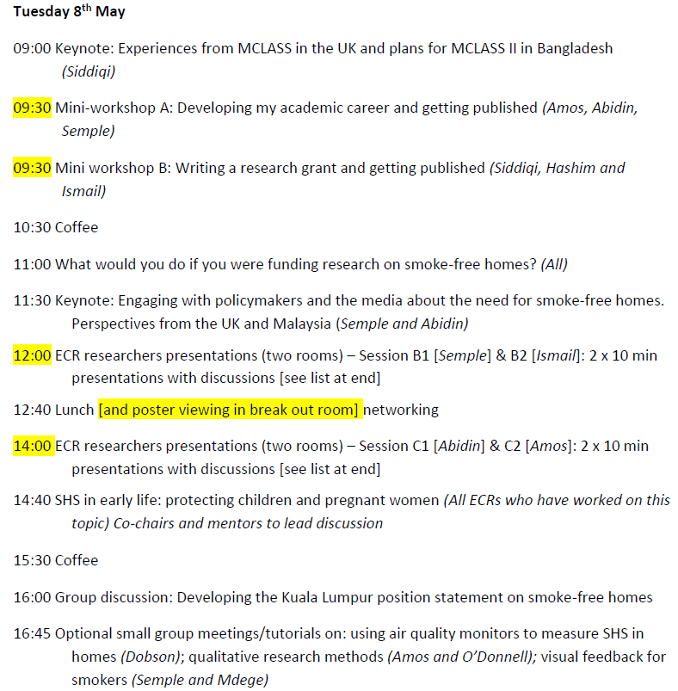

Slide 4
Mini-workshops – sign up
Workshop A
Developing my academic career and getting published
Remain here (Platinum Ballroom)
15 places
Workshop B
Writing a research grant and getting published
Level 2 – Gold/Silver Room
15 places
Poster session
Remember to sign-in each day
Please keep all travel receipts
Remember to tweet - #SmokeFreeKL18
Tomorrow in Gold/Silver Room during lunch
Please visit and discuss with presenters

Slide 5
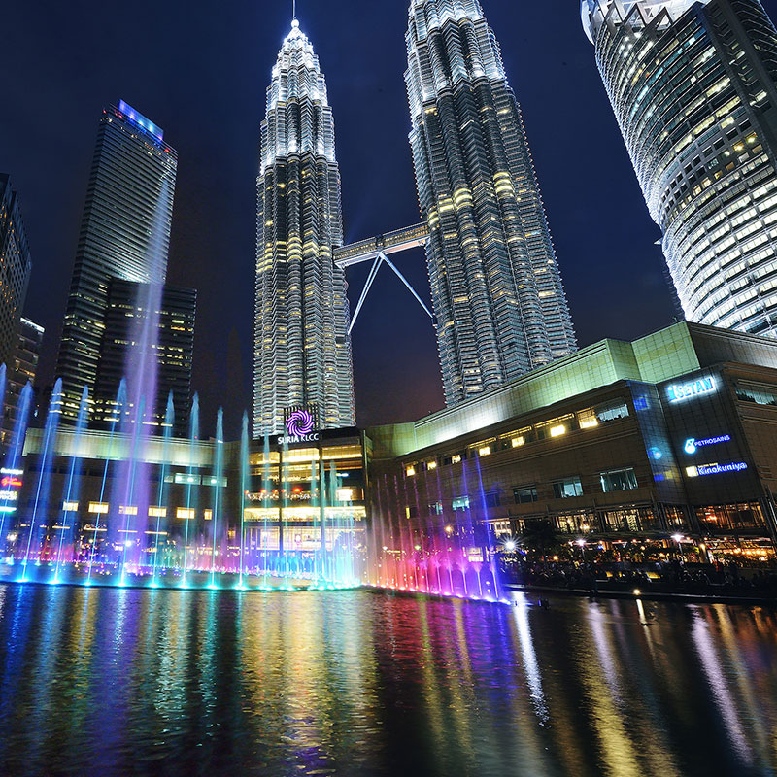
Evening meal tonight
Where: here in Novotel Qing Zhen Restaurant Level 2
When: 6.30pm
Walk over to KLCC Park to see the dancing water fountains at the Lake Symphony afterwards
Back here tomorrow for a 9am start

