Slide 1
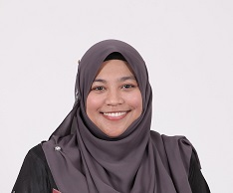
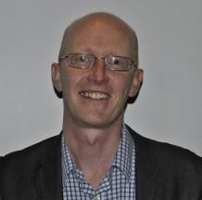
Welcome – Selamat Datang
Emilia Zainal Abidin
Associate Professor
Department of Environmental and Occupational Health
Faculty of Medicine and Health Sciences
Universiti Putra Malaysia
za_emilia@upm.edu.my
Sean Semple
Associate Professor
Institute for Social Marketing
Faculty of Health Sciences and Sport
University of Stirling
sean.semple@stir.ac.uk

Slide 2
The workshop
An exchange of knowledge and ideas
Aim is to learn from one another about how to increase the number of smoke-free homes in Malaysia, in the UK and globally
Brainstorming, keynotes, group discussions, early career researchers presentations, posters, mini-workshops, small group tutorials, coffee, lunch and dinners – and some speed networking!
A position paper on smoke-free homes research
What should we be aiming for? What do we need to do? How can we do it?
Build collaboration and friendships
It is your workshop

Slide 3
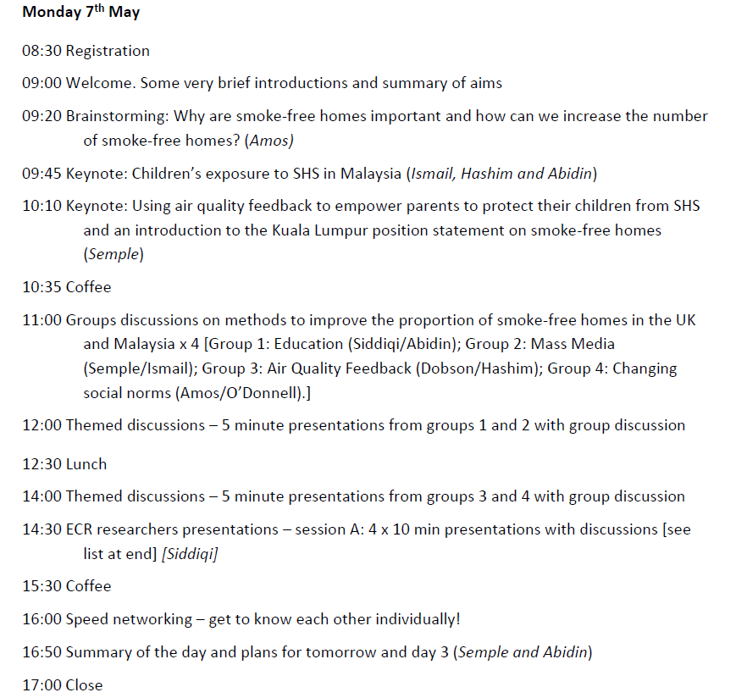

Slide 4
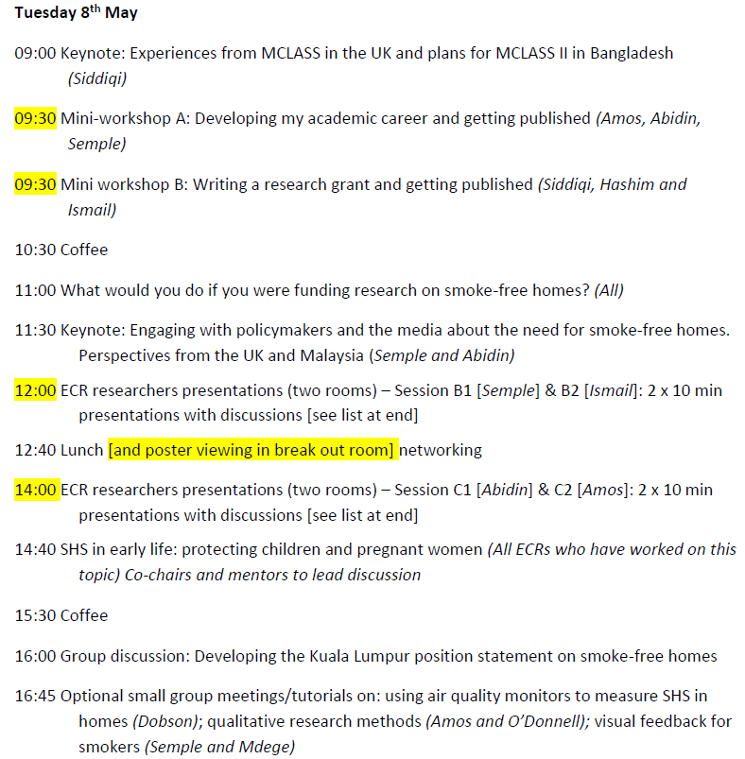

Slide 5
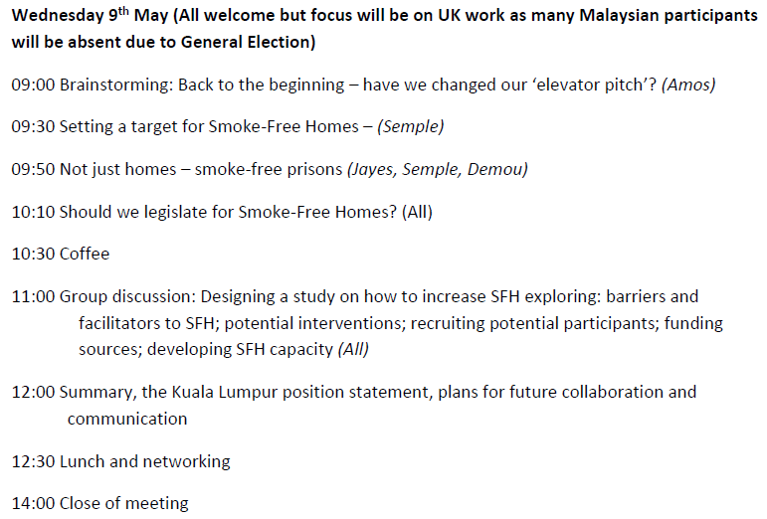

Slide 6
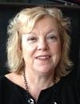
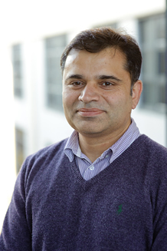
Some introductions
Professor Amanda Amos
Professor of Health Promotion
University of Edinburgh
Professor Noor Hasim Ismail
Professor of Community Health
University Kebangsaan Malaysia
Professor Zailina Hashim
Professor of Environmental & Occupational Medicine
Universiti Putra Malaysia
Professor Kamran Sidiqqi
Professor of Public Health
University of York

Slide 7
Digital and online information
The presentations will be brought together on a website after the workshop
www.smokefreehomes.network
Please also tweet to share questions and thoughts
@SFHWorkshopKL
#SmokeFreeKL18

Slide 8
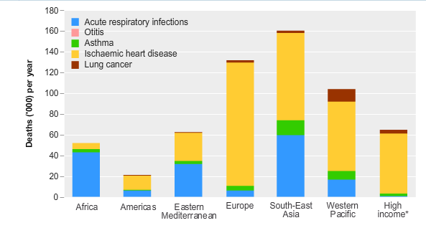
Health effects of SHS
SHS causes 600,000 deaths per annum globally
1% of global health burden of mortality
40% of children are exposed to SHS regularly
>400 million children in SE Asia exposed to SHS

Slide 9
Let’s get started - why are smoke-free homes important?
Professor Amanda Amos

