Slide 1
Using air quality feedback to empower parents to protect their children from SHS
Sean Semple
Associate Professor
Institute for Social Marketing
Faculty of Health Sciences and Sport
University of Stirling
sean.semple@stir.ac.uk

Slide 2
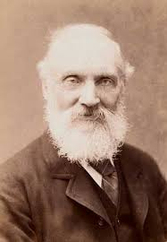
Lord Kelvin
"To measure is to know.“
"If you can not measure it, you can not improve it."
Though he did also say…
"X-rays will prove to be a hoax."
Notes:
William Thomson, 1st Baron Kelvin, OM, GCVO, PC, FRS, FRSE was a Scots-Irish mathematical physicist and engineer who was born in Belfast in 1824.

Slide 3
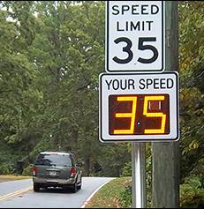
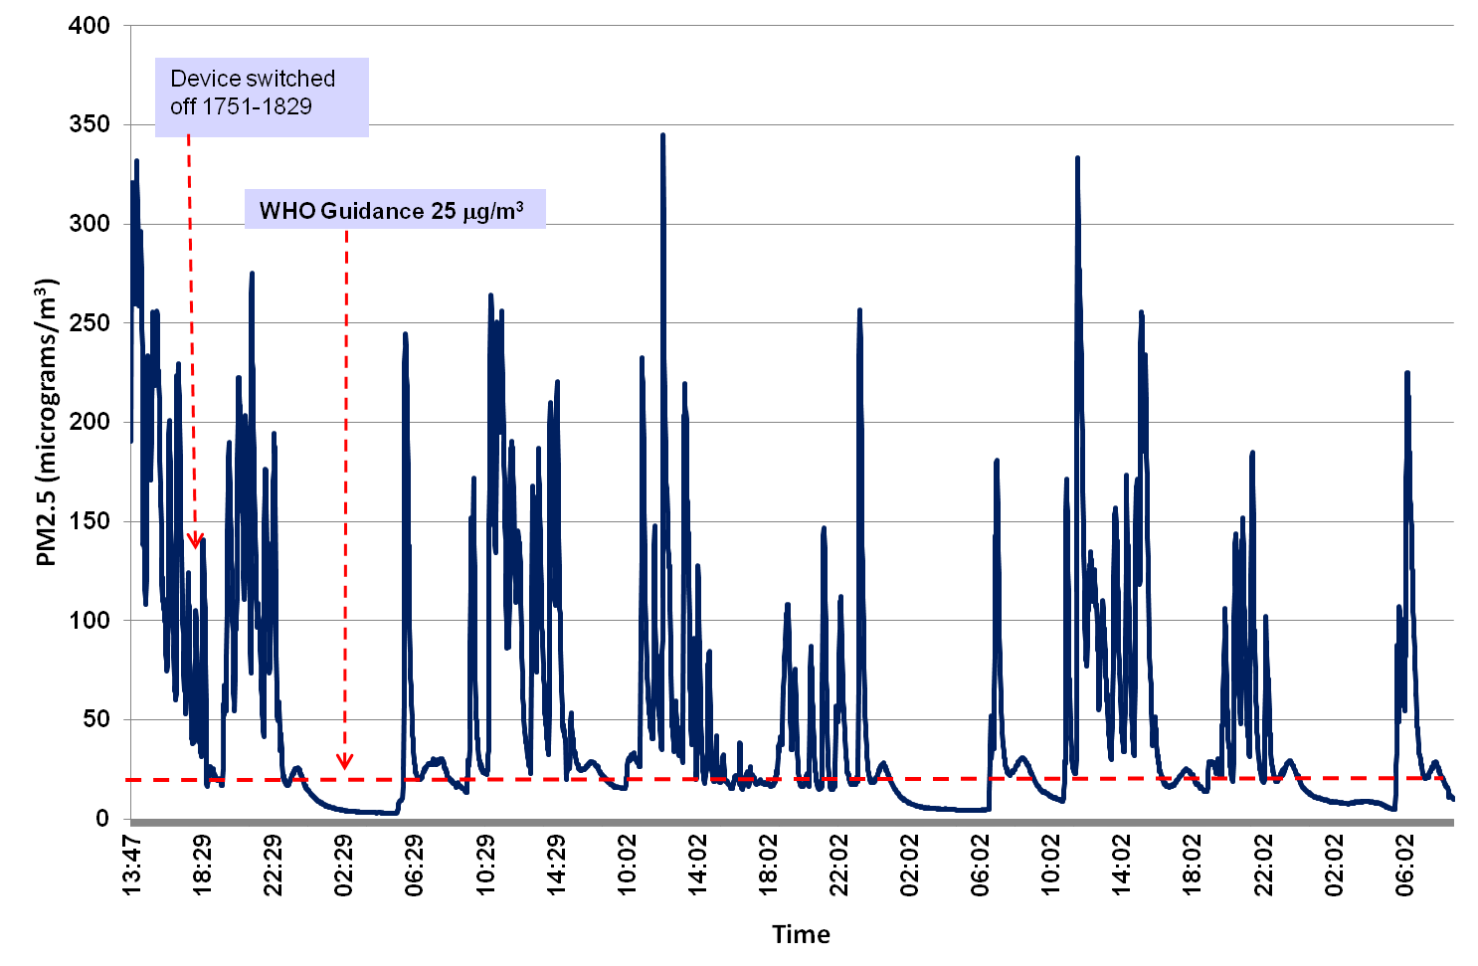
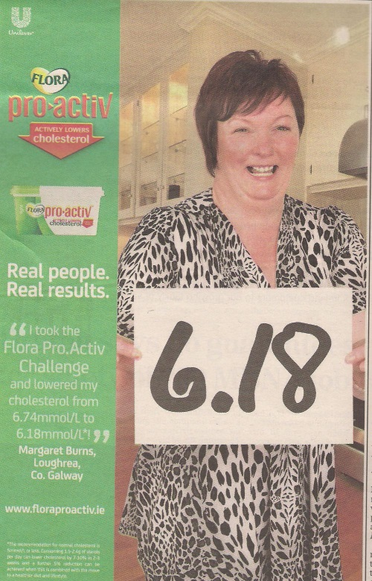
Using feedback for behaviour change
We use personalised feedback to change many types of behaviour (speeding, cholesterol, weight)
Can we use measurement of household air quality to encourage parents to make their homes smoke-free?

Slide 4
A very quick digression….about PM

Slide 5
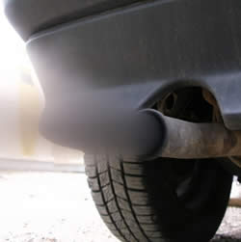
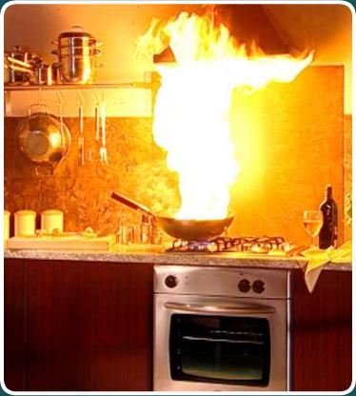
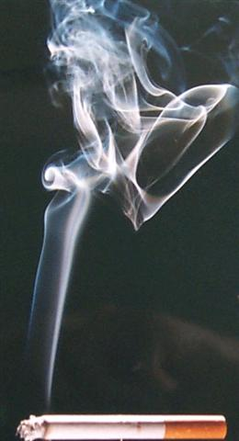
PM_{2.5}
Small particles that are inhaled in to the deep areas of the lung
Lots of epidemiological evidence that PM_{2.5} air pollution is linked to respiratory and cardiovascular health effects
Formed when we burn things – combustion
Biomass fuel
Vehicle and industrial emissions – particularly diesel engines
Forest fires
Cigarette smoke
And usually a small contribution from wind blown soil, sand and dust

Slide 6
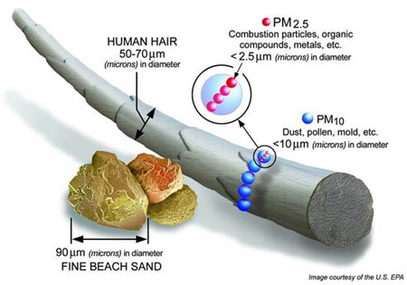
PM_{2.5} = Particulate less than 2.5 micrometers in size

Slide 7
Outdoor air quality targets for PM_{2.5}
US EPA Air Quality Index
PM_{2.5} μg/m³ | AQI | Advice
35 | Unhealthy for sensitive groups | Heart/lung disease and elderly/ children advised to reduce prolonged exertion
65 | Unhealthy | Heart/lung disease/elderly/children avoid prolonged exertion; everyone reduce prolonged exertion
150 | Very unhealthy | Heart/lung disease avoid all physical activity; everyone avoid prolonged exertion
250 | Hazardous | Heart/lung disease remain indoors; everyone avoid physical activity
WHO Air Quality Guidance*: PM_{2.5}
10 μg/m³ annual mean
25 μg/m³ 24-hour mean
* Adopted as suitable guidance for Indoor Air Quality in enclosed spaces (Dec 2010)

Slide 8
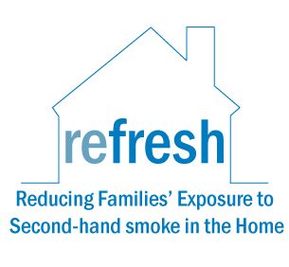
Reducing Families' Exposure to Second-hand Smoke in the Home
(REFRESH)
A collaborative study by the
University of Aberdeen, ASH Scotland and the
University of Edinburgh.

Slide 9
Aims of REFRESH
Pilot study
Provide mothers who smoke with information about SHS & levels of particulate matter (PM_{2.5}) in their own home
Change their smoking behaviours
Reduce their child’s levels of SHS exposure
Recruitment
Smoking mothers in Aberdeen/shire identified through GP records
Mothers sent a letter and returned a reply slip if interested
1693 invited → 59 agreed to take part (3.5%)
Randomised to Standard or Enhanced group

Slide 10
Study design: compared two groups
Visit 1
Visit 2 (+24h)
Visit 3
(+4 weeks)
Visit 4 (+24 h)
Health & SHS exposure questionnaire
Daily grid
Saliva sample
Set up SidePak
‘Motivational interview’
Collect SidePak
Change questionnaire
Daily grid
Saliva sample
Set up SidePak
Collect SidePak
Feedback
Standard
No PM_{2.5} feedback until Visit 4
Enhanced
PM_{2.5} levels shown to mother at Visit 2
Extended interview at visit 4

Slide 11
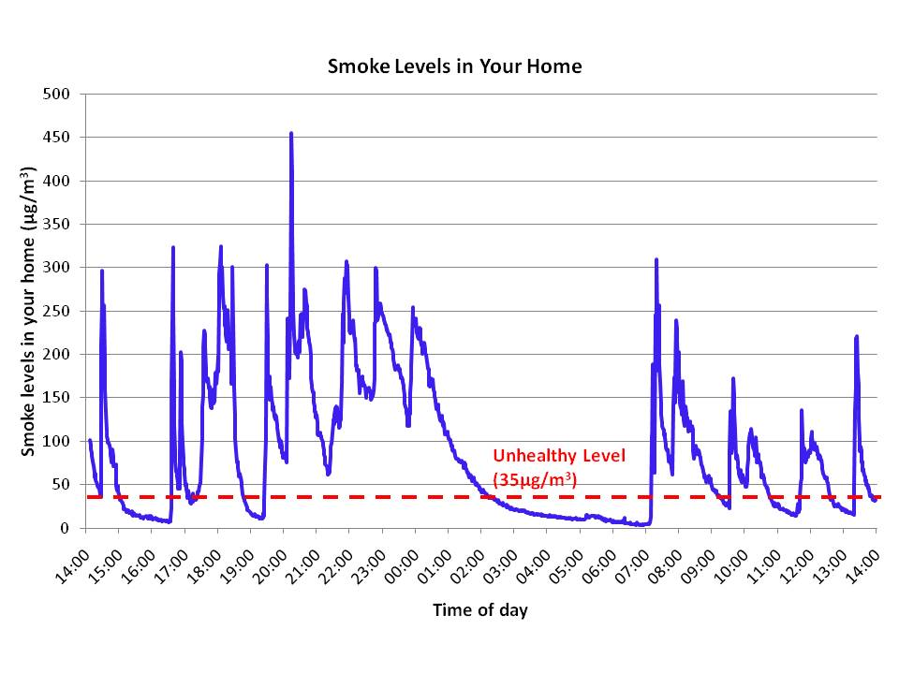
Air quality feedback

Slide 12
REFRESH results
Small numbers so differences between groups are not statistically significant
Enhanced group experienced much larger changes in all indicators of exposure at 1-month
Exposure reductions are of the order of about one-third to one-half

Slide 13
Findings from interviews with the Enhanced group
Reaction to PM_{2.5} levels was ‘shock’
Existing behaviour thought to protect child
Important that information was personalised
Graph acted as reminder and tool for sharing information with others
Primary motivation to reduce exposure was child’s health
“Seeing the results made a big difference. It was like a shock because I didn’t realise. Like I don’t sit here and smoke in front of (my child), I do it in the kitchen, but for the readings to be high like that when I’m not like anywhere near it, if you know what I mean, it’s like a shock factor to realise what it can do. So I think that’s the best thing that like helped me.” (23, visit 4)

Slide 14
But….many barriers to using REFRESH
Recruitment was low (<4%)
Approach via GP probably not ideal
Required researcher to visit the home (complex set up)
Equipment was noisy
For providers the equipment is expensive (£2000) and method is labour intensive – primary care providers thought it wasn’t implementable
Looks to be a promising method but we need another way of engaging with smokers and delivering the intervention
“We’re gonna need a bigger (different) boat!”

Slide 15
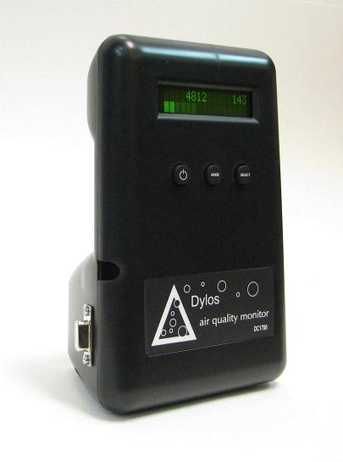
First Steps to Smoke-Free Study
Teamed up with NHS Lanarkshire First Steps Programme
Does providing air quality feedback help people make their homes smoke-free?
Randomised trial: two groups (A+B)
Group A receive standard NHS advice about SHS
Group B receive this advice + personalised feedback about SHS levels
SHS levels measured by health care workers using a low-cost laser particle counter (Dylos DC1700) left in each home for 4-7 days
Repeat measurements at +1 and +6 months later

Slide 16
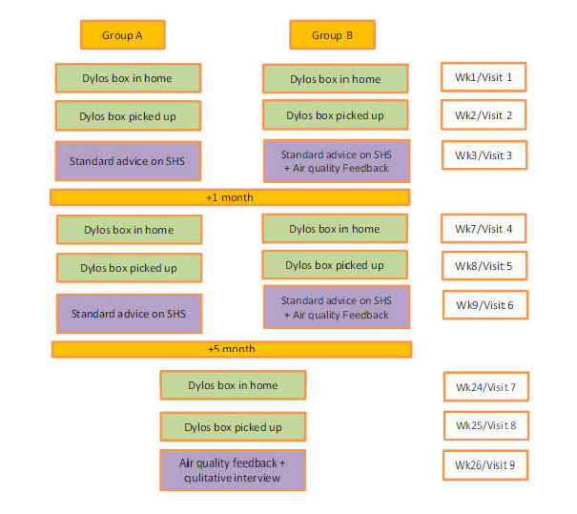
What we did…
120 first-time mums recruited (70% response rate) (62A+58B)
117 homes took part in baseline
102 took part @1 month follow-up
78 took part @6 month follow-up
21 qualitative interviews

Slide 17
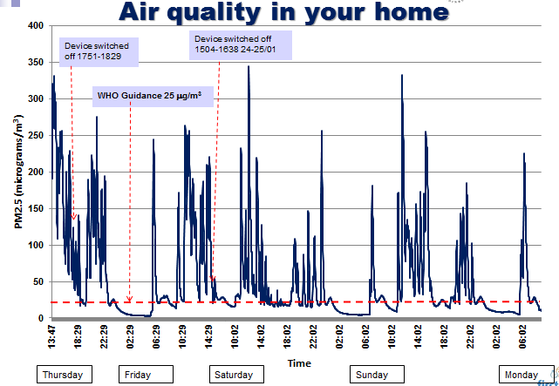
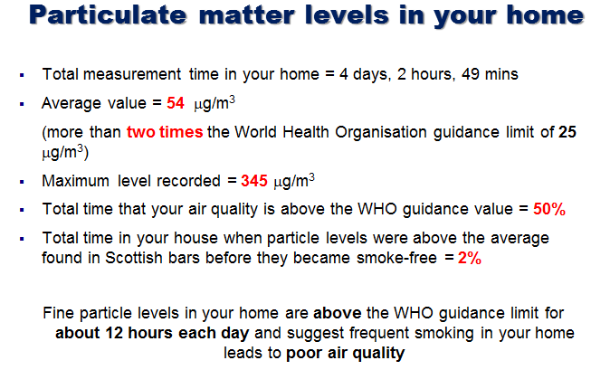
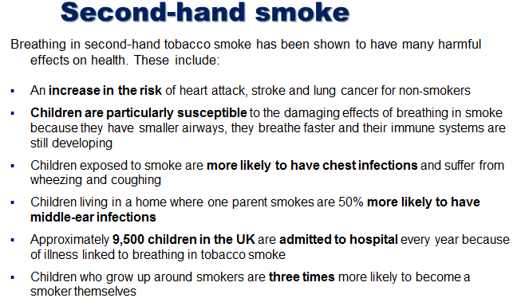
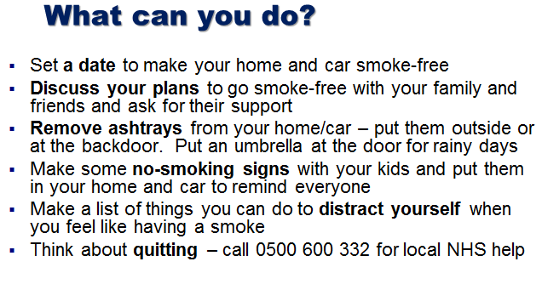
Feedback – what did it look like?

Slide 18
Participant characteristics
 | Group A (n=59) | Group B (n=58)
Age (IQR) | 21 (18-22) | 20 (19-23)
SIMD decile (IQR) | 2 (1-4) | 2 (1-4)
Ante/post natal | 39%/61% | 17%/83%
Housing | 68% flat | 71% flat
Garden space | 75% | 64%
Mean measurement duration 5.3 days at each visit
Total measurement data: 2,278,614 minutes

Slide 19
Results – baseline SHS measurements

Slide 20
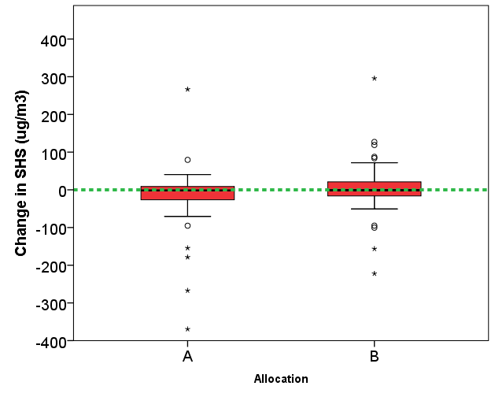
Differences between groups @ 6 months
SHS levels higher @6 months
SHS levels lower @6 months
Notes:
Looking at the 77 pairs where >1440 minutes of data at both baseline and @ 6 months
Difference* between 6-month and baseline PM_{2.5} measurements for Group A (n=40) was -1.7 (26.5, -8.8); Group B (n=37) was -1.0 (21.2, -16.2) μg/m³ with no statistical difference between the groups (p=0.16)

Slide 21
Quotes from smoking parents
“It [the monitor] helped me a lot…helped me realise what I was doing to my family by smoking inside. I think without that [the monitor] it would have took a lot more to push me to get fully outside rather than sitting in here [the living room] at night time. It pushed me to ….cut down at least…and hopefully stop [smoking] soon.”
“I was shocked ..we smoke in the kitchen and only in here when [child’s name] is out of the house or in bed, so I cannot believe how high it [the PM2.5 levels] was.”

Slide 22
Limited physical opportunities...
“I’m on the 13th floor of a high rise and the only place I can get to have my cigarette is in the kitchen, because the bedroom – he sleeps in there. I can’t smoke in there, I wouldn’t risk it. The bathroom, I wouldn’t smoke in. We both share that, and then in here [living room], we both share. The only place he doesn’t go is in the kitchen, so that’s the only place I can go to have a cigarette. I can’t exactly go out 13 floors just to have a cigarette, just to come in and find out he’s been screaming for the last 5 minutes.”
Notes:
22 year old single Mum, with a 10 month old child, living in a one-bedroom flat on the 13th floor.

Slide 23
Discussion of results
Providing feedback to this group of young mothers did not change the measured levels of SHS in their homes
The evidence not sufficient to enable implementation of air quality feedback for this group of mothers
Why?
The enhanced intervention increased mothers’ capability to change their smoking behaviour in the home, and their motivation to act. But when social and physical opportunities are limited, changing smoking behaviour in the home is less feasible.
Many barriers to making their homes smoke-free
Distance to outside is large (particularly for those living in flats)
Parents often alone with children so can’t leave child in home while they go outside to smoke
Think they are already doing enough to reduce children’s exposure (opening windows, using fans, lighting candles)
Persuading other adults who smoke to change their behaviour
Stigma of smoking outside

Slide 24
Acknowledgements
NHS Lanarkshire
Tracy Henderson
Susan Lyttle
Lynn Adams
Shirley Mitchell
Lisa Bruce
Celia Briffa-Watt
All First Steps Workers
All parents who took part
University of Aberdeen
Steve Turner
David Harrison
University of Edinburgh
Amanda Amos
RCO Consulting – Rachel O’Donnell
Project Advisory Board
Deborah Ritchie
John Watson (ASHS)
James Cant (BHF)
Celia Gardiner (NHS HS)
Project was funded by a grant from the Chief Scientist Office (CZH-4-983)

Slide 25
Progress since
AFRESH project and TACKSHS – more later…
Real-time feedback and SMS messaging

Slide 26
The Kuala Lumpur position statement on Smoke-Free Homes – first draft
Children’s exposure to SHS continues to be a major health problem globally.
Children’s exposure to SHS primarily occurs in their own home, as a result of parental and other adult smoking activity. Concentrations of SHS in the confines of a home can be extremely high.
The long-term benefits of reducing children’s exposure to SHS are substantial.
Children have a right to a living environment free from SHS.
Parents want what is best for their child and are often unaware that smoking at home can lead to high SHS exposures that can be harmful.
Governments, health practitioners and wider society all have a duty to protect children from the harms caused by SHS exposure.
Governments should develop public health policies to help encourage parents to have a smoke-free home and these should include:
mass media campaigns about the benefits of a smoke-free home;
education relating to the health effects of SHS on children;
a national 5 year and 10 year target for reducing the proportion of children exposed to SHS at home;
consideration of practical support and legislative measures to encourage parents to provide a smoke-free home for their children.
The research community has a responsibility to find innovative and effective ways of working with parents to make their homes smoke-free.

