Slide 1
How do we improve the proportion of smoke-free homes in Malaysia and the UK?
Group discussion

Slide 2
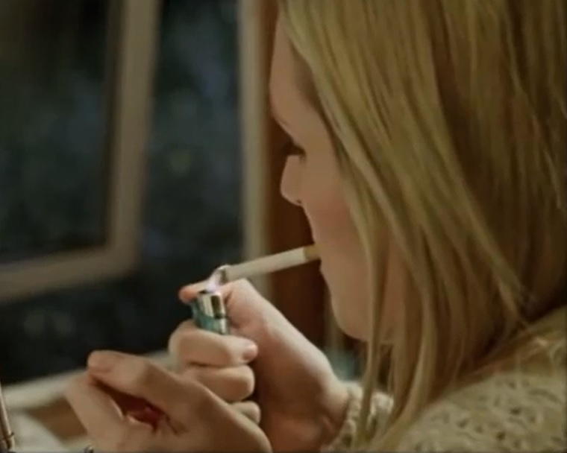
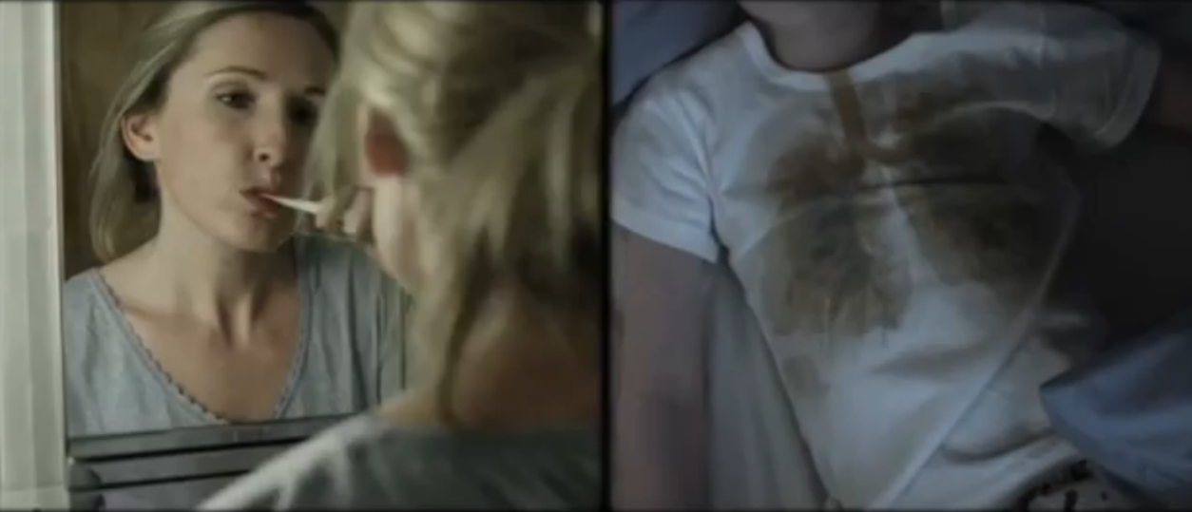

Slide 3
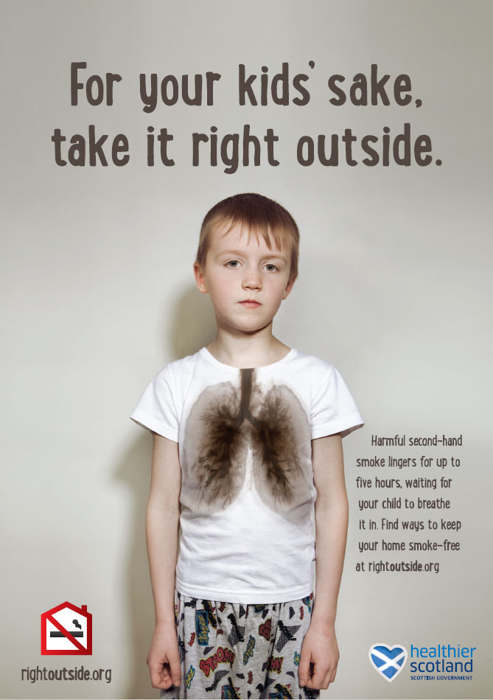
How can we protect the 1 in 4 still exposed to SHS?
Education and increasing awareness is key to empowering smokers to make their homes smoke-free
SHS lingers in the air for up to 5 hours after you’ve smoked²
85% of SHS is invisible³
Mass media campaigns like Rightoutside⁴ should be repeated
Scottish Government campaign www.rightoutside.org
Scottish Government target of reducing by half the proportion of children exposed to SHS at home by 2020
¹Vijayaraghavan et al. Am J Public Health. 2013;103:2276–83.
²Semple & Latif .Nicotine Tob Res. 2014;16:1365-70.
³Geeet al. Tob Control. 2013;22:429.
⁴ www.rightoutside.org

Slide 4
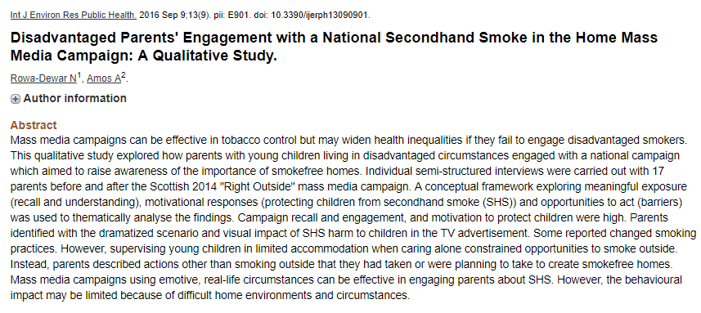

Slide 5
Mass media – Malaysian adverts
https://www.youtube.com/watch?v=SiDNOklQOVk
The next advert
- Relate with the environmental impact of ‘haze issue’ in Malaysia
Focus on fathers and grandparents
Also focus on others in the home who may be exposed (not just children)
Pregnancy
Elderly
Asthma
Respect non-smokers, good moral values
Voice of children –SFH ambassador

Slide 6
Isn’t SHS exposure a thing of the past?
How many non-smoking adults in Scotland would show measurable biochemical evidence of breathing second-hand smoke if we measured today?
Approximately 850,000 of those over 16 in Scotland right now…
That’s 1 in 4 of all non-smoking adults in Scotland¹
How many parents self-report that their child lives in a home where smoking (indoors) occurs?
Approximately 6% of children¹– that’s 55,000 under 16.
¹Scottish Health Survey 2015 data

Slide 7
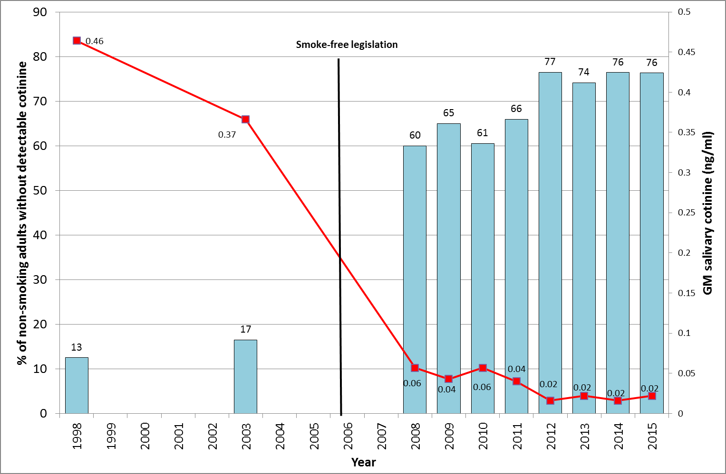
We’ve come a long way…

Slide 8
Success, but have we stalled?
Smoke-free legislation - a huge public health success
Imagine introducing a measure that achieved a 95% reduction in exposure to outdoor air pollution from diesel fume…
But in the past 5 years the proportion of adult non-smokers with detectable cotinine
Has not changed from 76.5% in 2012 to 76.3% in 2015
The Geometric Mean salivary cotinine in adult non-smokers
Is flat-lining between 0.016 to 0.022 ng/ml between 2012-5

Slide 9
So what do you think works (and doesn’t work)?
Divide up in to four groups of about 8-10 in each group
Spend the next hour thinking about what would work and sharing your experiences/research findings.
Prepare a short presentation (<5mins; 3 slides maximum) with main findings and thoughts for us all to discuss
Group 1 and 2: 12-12.30pm
Group 3 and 4: 2-2.30pm

Slide 10
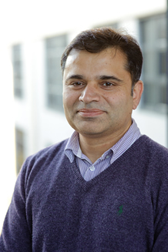
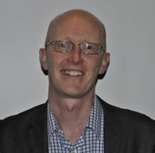
Groups
Group 1: Education
Group 2: Mass media
Group 3: Air quality feedback
Group 4: Changing social norms

