Slide 1
Providing visual feedback on SHS levels
Tutorial

Slide 2
This has evolved…
Image from BHETSE to
REFRESH
AFRESH/TACKSHS
How to provide complex data and concepts to a lay audience

Slide 3
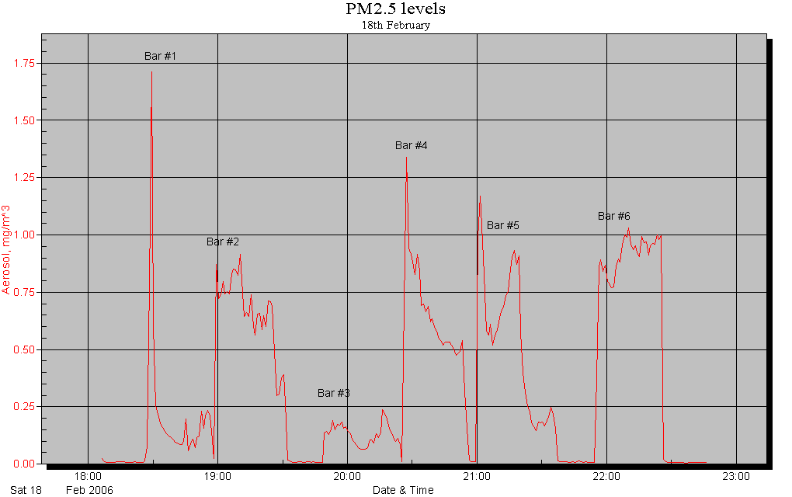
BHETSE – bar workers’ exposure to SHS

Slide 4
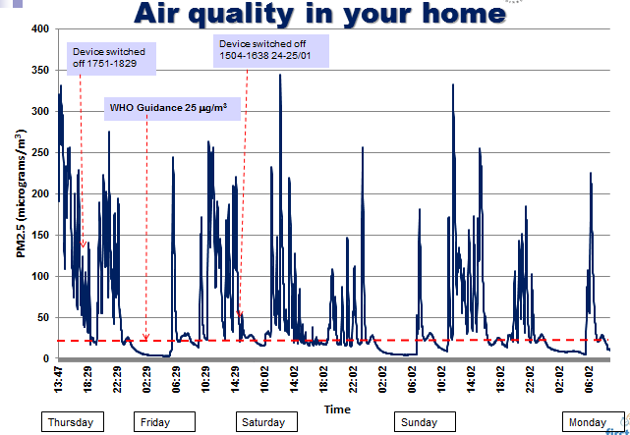
First Steps feedback

Slide 5
TACKSHS feedback

