Slide 1
Not just homes - smoke-free prisons
Sean Semple
Associate Professor
Institute for Social Marketing
Faculty of Health Sciences and Sport
University of Stirling
sean.semple@stir.ac.uk

Slide 2
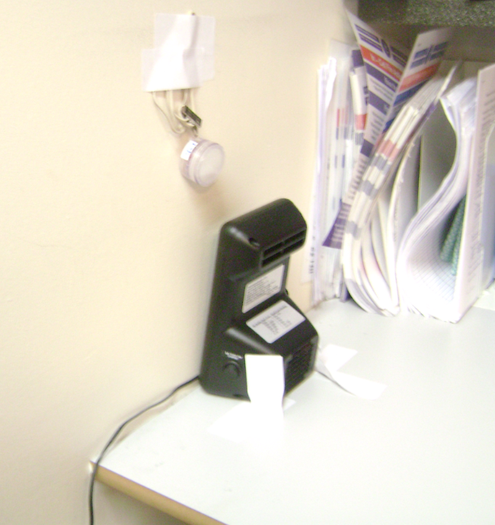
Tobacco in Prisons Study (TIPs) Air quality data collection
All 15 prisons measured between 30th September and 22nd November
Measurement duration mean was 5.9 days (7301-8704 mins)
Total 128,431 minutes of data on PM_{2.5} concentrations (>2100 hours)
Outdoor PM_{2.5} data from nearest local authority outdoor fixed site measurement station to provide adjustment for ambient air pollution
Mobile/task-based measurements (~30 minutes)
86 in total (range 2-8) >40 hours of task-based data
12 prisons had complete contemporaneous data for Dylos (PM_{2.5}) and airborne nicotine

Slide 3
Some comparative PM_{2.5} figures
There is no UK or International Workplace Exposure Limit for SHS
PM_{2.5} guidance from World Health Organisation (WHO)
25 μg/m³ averaged over 24h
10 μg/m³ averaged over a year
Median from smoke-free homes in Scotland: 3 μg/m³
Median in smoking homes in Scotland: 31 μg/m³
Median in pre-ban Scottish bars :246 μg/m³
Median outdoor in Scotland: 9 μg/m³
Median Dylos 6-day across 5 prisons in E&W 36 (range 27-70) μg/m³
corrected for outdoor air median becomes 16 (range 13-62) μg/m³

Slide 4
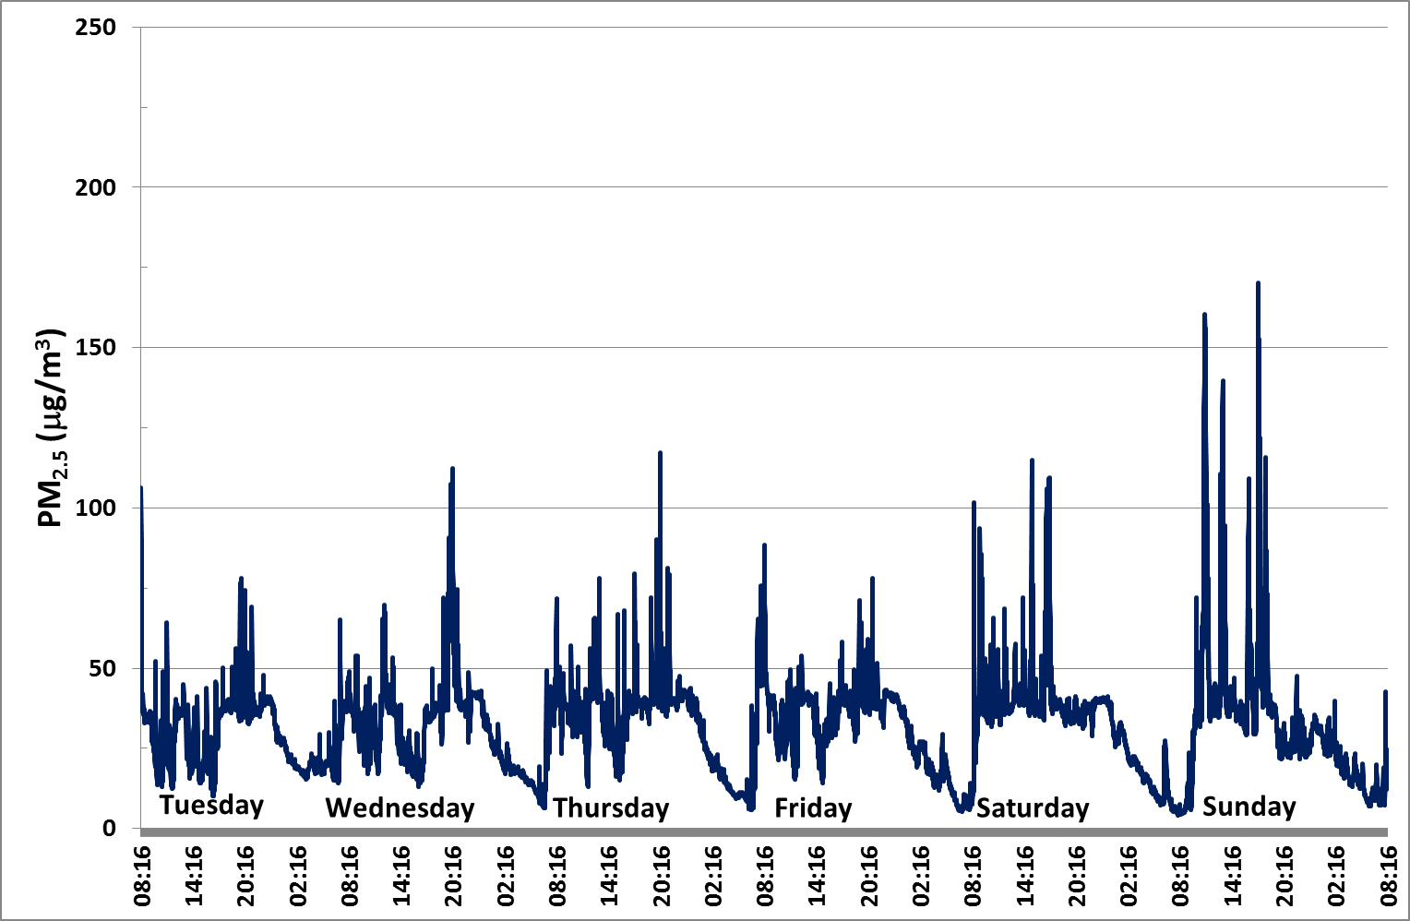
PM_{2.5} time plots – HMP Grampian
Clear diurnal pattern
Modern prison
‘Median’ prison with values nearest the average for all 15 prisons

Slide 5
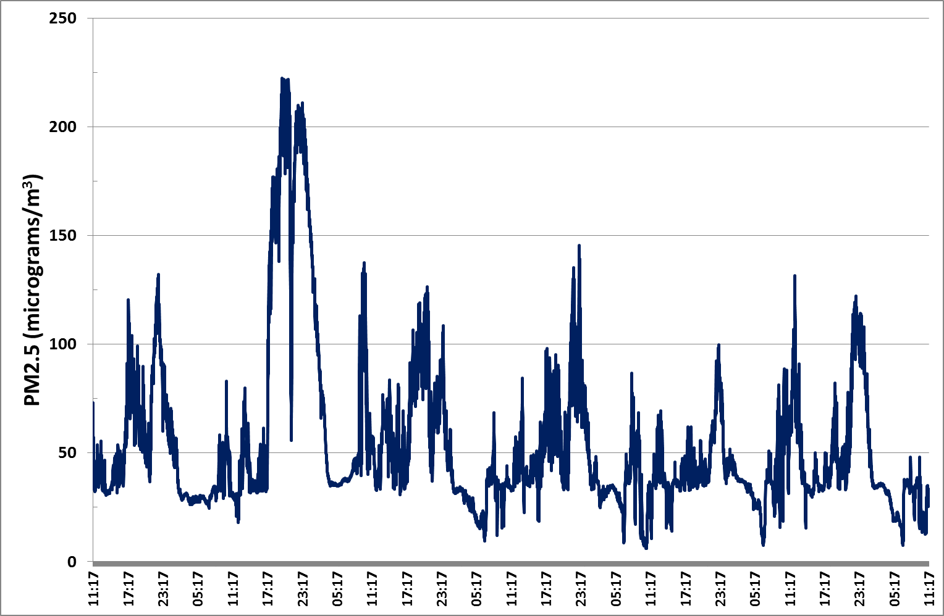
PM_{2.5} time plots – HMP Barlinnie
Victorian prison
Much higher concentrations extending through night - poorer ventilation

Slide 6
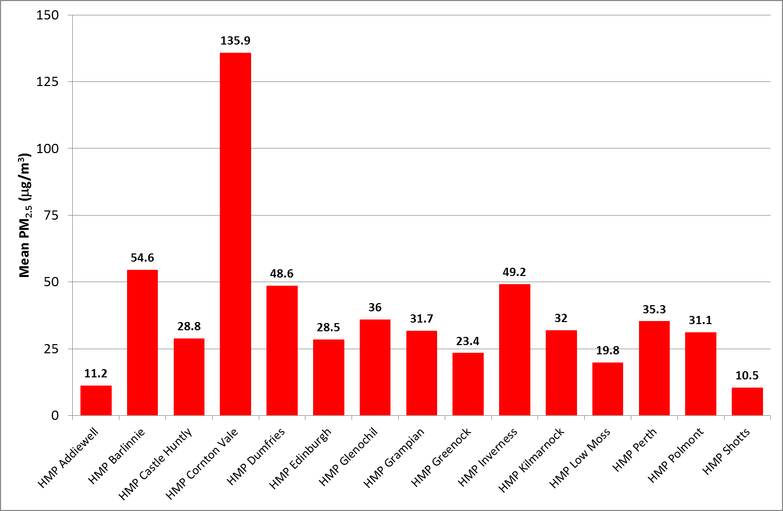
Static PM_{2.5} measurements
WHO 24h guidance
WHO annual guidance

Slide 7
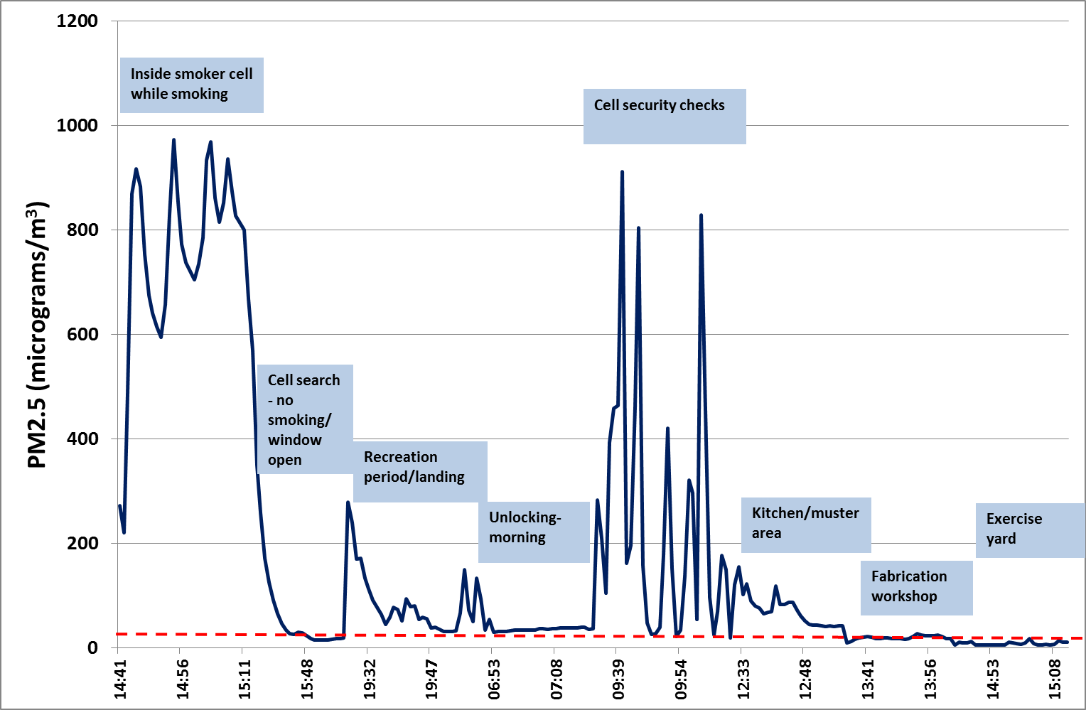
Mobile PM_{2.5} data – example from HMP Barlinnie
Using 12 prisons where contemporaneous data exist
Indicates that PM is a very good proxy for SHS

Slide 8
Mobile PM_{2.5} data - example
A typical cell in E hall - cell occupied by 1 smoking status prisoner. Monitor located on cell shelf. Cell door was old timber style which was closed and cell window was also shut. Observed prisoner smoking two roll up cigarettes, he advises he smokes c35 a day.
Using 12 prisons where contemporaneous data exist
Indicates that PM is a very good proxy for SHS

Slide 9
Mobile PM_{2.5} data - example
E hall cell search- occupied by 2 smokers. Test was an unannounced cell search. Occupants stated they last smoked 30 mins before staff entered. Cell window was open, door was shut whilst prisoners were searched individually then door was wide open for duration of cell search.
Using 12 prisons where contemporaneous data exist
Indicates that PM is a very good proxy for SHS

Slide 10
Mobile PM_{2.5} data - example
D hall -section D south Lower (high dependency unit) - Recreation Period. Situated in the main landing atrium area during a recreation period.
It has capacity for 51 and there was 46 prisoners located in the unit at the time of testing, 14 were out on recreation in the atrium area and the remainder were locked in their cells, no one is allowed to smoke with their cell door open. Only 2 of the 46 prisoners are non-smokers.
Using 12 prisons where contemporaneous data exist
Indicates that PM is a very good proxy for SHS

Slide 11
Mobile PM_{2.5} data - example
A hall – Daily cell security checks. Cell security checks are carried out daily by all Officers, they involve spending around 1-2 minutes checking the security and fabric of each cell individually, whilst the occupants are there or not.
We checked 34 of cells in 30 minutes.
Using 12 prisons where contemporaneous data exist
Indicates that PM is a very good proxy for SHS

Slide 12
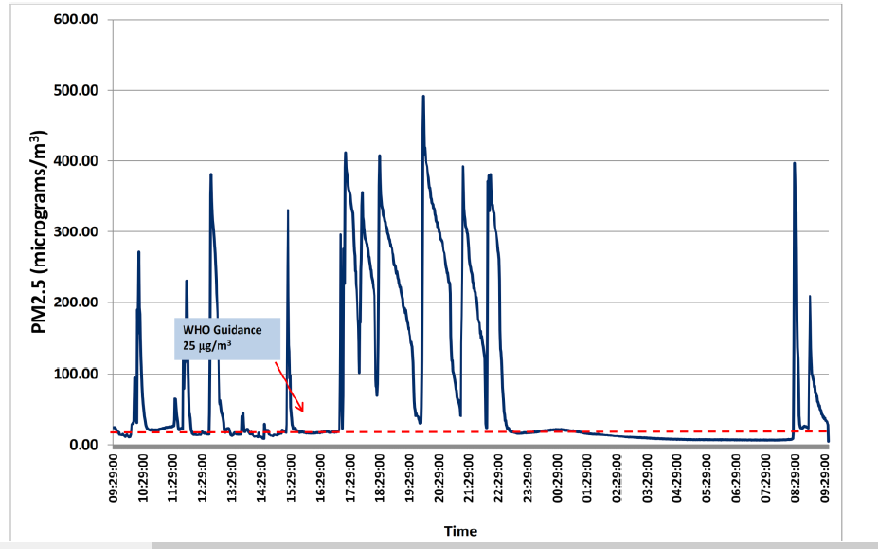
SHS levels in smoking cell

Slide 13
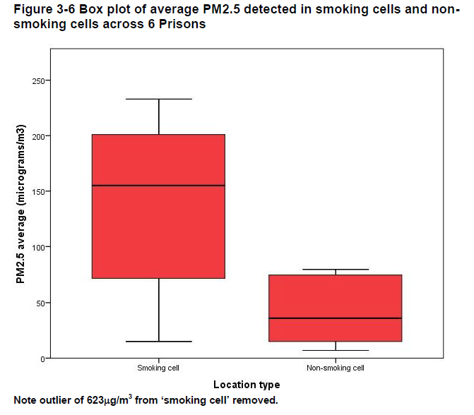
SHS levels in smoking and non-smoking cells (England & Wales)

Slide 14
Acknowledgments
All staff at the Scottish Prison Service and in HMP Kilmarnock and HMP Addiewell who assisted with this study
David Walker, Ruaraidh Dobson and Mrs Flora Buthlay for their help with data collection and retrieval of instruments from prisons
Co-authors of this work: Prof Kate Hunt, Dr Helen Sweeting, Dr Rachel O’Donnell, Dr Greig Logan, Dr Evangelia Demou.
Co-investigators in the TIPs research team to the overall design of the TIPs study (Professor Linda Bauld, Dr Kathleen Boyd, Dr Philip Conaglen, Dr Peter Craig, Douglas Eadie, Professor Alastair Leyland, Professor Jill Pell)
Funded by the National Institute for Health Research Public Health Research Programme (15/55/44). Disclaimer: The views and opinions expressed are those of the authors and do not necessarily reflect those of the Public Health Research Programme, NIHR, NHS or the Department of Health

Slide 15
Not just prisons – homes are workplaces too…
Domiciliary health and care workers (including Home Health Care Professionals or Community Staff) are one of the largest remaining occupational groups that continue to experience frequent and high concentrations of SHS as part of their work activity.
There are over 600,000 workers employed in this sector in the UK, over 2 million in the USA and growing numbers globally carrying out nursing and care tasks that involve entering private residences where smoking is unrestricted by law.
The workforce is predominately female and estimates suggest the number of workers employed in this sector are likely to increase as life expectancy rises and elderly people are cared for within their own home.
Very little is known about the exposure of these workers to SHS

