Slide 1
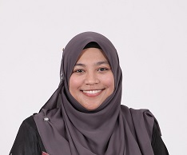
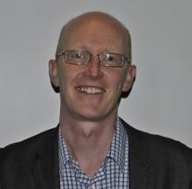
Summary, thank you and until next time…
Emilia Zainal Abidin
Associate Professor
Department of Environmental and Occupational Health
Faculty of Medicine and Health Sciences
Universiti Putra Malaysia
za_emilia@upm.edu.my
Sean Semple
Associate Professor
Institute for Social Marketing
Faculty of Health Sciences and Sport
University of Stirling
sean.semple@stir.ac.uk

Slide 2
Summary – so what did we learn
Summary points to add
Summary points to add

Slide 3
So what did we learn? Day 1
UK not the same as Malaysia – need to be culturally sensitive
Malaysia nearly half of all men smoke; almost no women smoke
This impacts on how we approach education, health promotion, mass media and changing social norms
Directly to men but also – empower women to enforce smoke-free homes
Political will in Malaysia – more work needed
Need to be positive and upbeat about protection of children’s health
Don’t lecture or be negative about smokers’ behaviour
Use ALL existing health services to promote the SFH message
Integrate SFH/SHS effects in curriculum
Children are a good means of communicating the message about SFH
Using air quality feedback may have a role – especially linking to environmental information about ‘haze’ events

Slide 4
So what did we learn? Day 2 and 3
Gender issues are important in both countries, but slightly differently in Malaysia vs UK
Smoking prevalence 45% among men in Malaysia vs 1.5% among women, so essential to tackle fathers’ smoking
Can’t just be left to women in UK though! Need for a household approach to SFH interventions
Need to make smoke-free public places laws comprehensive and well-enforced
If it’s not comprehensive, it isn’t effective!
“Self-enforcement” culture is necessary to make smoke-free laws work
Points of access in Malaysia are different to the UK – need to be culturally aware
Can we adapt approaches from other countries, such as working with mosques?
Important to think how we can secure funding – can we work together with low income countries to access UK funding?
Adopt a “ smoke-free homes hub” approach?
Need country-specific evidence to make the case for smoke-free homes
Academics can’t do it on their own! Work with NGOs and civil servants to make change

Slide 5
Digital and online information
The presentations will be brought together on a website after the workshop
www.smokefreehomes.network
Please also tweet to share thoughts
#SmokeFreeKL18
Please keep in touch and send us news about the work you do in relation to SFH research
Exchange email addresses with one person you’ve met here and write to them next week!

Slide 6
Thank you
To Emilia and her students for helping with all of the logistics
To our four fantastic mentors for contributing their experience and knowledge
To the British Council and Newton Fund for funding the workshop
To you for coming and contributing your wonderful energy and enthusiasm
Best wishes and have a safe journey home

