Slide 1
SMOKE-FREE HOMES WORKSHOP 7-9th May 18 Group discussion: Changing social norms
Professor Amanda Amos, University of Edinburgh
Dr Rachel O’Donnell, University of Stirling

Slide 2
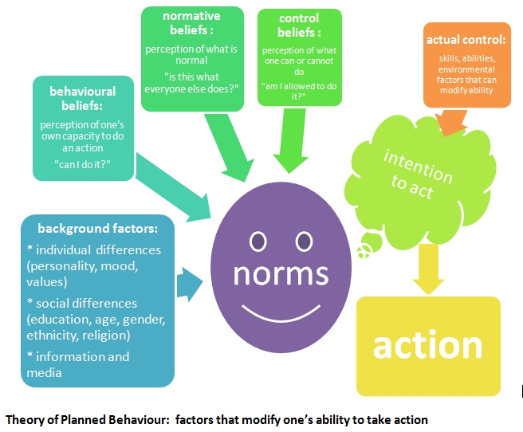
What are social norms?
Notes:
Social norms are shaped by a range of factors:
Background factors: gender, age, personality, religion, ethnicity, economic status etc
Behavioural beliefs: ‘do I have the capacity to do this’? (i.e. can I actually create a smoke-free home?)
Normative beliefs: ‘what does everyone else do’ (i.e. does everyone else have a smoke-free home?) - so what is expected of me?
Control beliefs: ‘Am I allowed to do this’
These norms combine to influence intention to act, which then translates into action (dependent on a range of other factors, including actual control)
I’ve borrowed our definition from the Theory of Planned Behaviour, a psychological theory which links beliefs and behaviour. First proposed by Ajzen in 1991, it has been widely applied to studies of the relations among beliefs, attitudes, behavioural intentions and behaviours in various fields such as advertising, public relations, advertising campaigns and healthcare.
The theory states that attitude toward behaviour, subjective norms, and perceived behavioural control, together shape an individual's behavioural intentions and behaviours.

Slide 3
How do social norms influence ability to create/maintain a smoke-free home (SHF)?
Social norms can contribute to a lack of perceived control re: creating a SFH (Passey et al 2016). This is especially so in communities where
a high value is placed on social relationships
smoking is seen as a shared social activity in work/business relationships, and at family events/celebrations.
In some cultures, it remains normal to smoke. In societies where smoking is becoming denormalised, smoking is not denormalised everywhere.
Social expectations of behaviour within a culture (eg associated with politeness/hospitality with visitors) can prevent household members from challenging others’ smoking behaviours
Notes:
Social expectations of behaviour relate closely to gender imbalance, i.e. women’s (mainly) lack of agency in effecting change in male smoking behaviours in their household.

Slide 4
WHAT INFLUENCES SOCIAL NORMS?
Social exposure to a behaviour (ie normative influences):
‘The composite ways through which people see that
behaviour in their social, physical and symbolic
environments.’
ie what behaviours are acceptable (ie normative) in which contexts
Source: Mead et al (2014) Understanding the sources of normative influence on behaviour: The example of tobacco. Social Science and Medicine, 115, 139-143.
Notes:
Social expectations of behaviour relate closely to gender imbalance, i.e. women’s (mainly) lack of agency in effecting change in male smoking behaviours in their household.

Slide 5
Here are a few examples…
“By smoking together we develop a connection of friendship and relationship (‘guanxi’), which is important in the Chinese culture.” (Abdullah et al, 2012)
“They (mothers) felt pressurised by the norms and expectations of their particular social environment(s) [which were in contrast to the wider social expectations of NOT smoking around children] to provide an uncritical environment [in the home] where people can smoke…” (Robinson, 2008)
Notes:
Here’s a couple of examples…
Abdullah AS, Hua F, Xia X, et al. Second-hand smoke exposure and household smoking bans in Chinese families: a qualitative study. Health Soc Care Community 2012;20:356–64.
Robinson J. ‘Trying my hardest’: the hidden social costs of protecting children from environmental tobacco smoke. Int Rev Qual Res 2008;1:173–94.

Slide 6
SOCIAL EXPOSURE AND SOCIAL NORMS AROUND SMOKING IN THE HOME
Social norm | Definition | Examples
Social environment | Exposure to others engaging in the phenomenon | Observing smoking behaviour of family members, friends, peers in the home and elsewhere
Physical environment | Exposure to phenomenon through physical sites and spatial restrictions | Restrictions and no-smoking signs, presence/absence of ashtrays in homes, smoking shelters
Symbolic environment | Exposure to official and unofficial health promotion messages, advertisements, media | Statements about relative harm of SHS and children’s exposure from public health organisations, health professionals, schools, coverage in news and social media, depictions of smoking in TV/films

Slide 7
Discussion areas:
How might social norms influence ability to create/maintain a smoke-free home in your country?
Are social norms re: smoking in the home changing? Why? If not, how could they be changed through social, physical and symbolic environmental influences?
What might be the unintended consequences of changing social norms related to smoking in the home?

