Slide 1

Ramadan- Seizing the divine opportunity towards SMOKING CESSATION
Content
Environmental influence
- Scientific perspective
- Islamic perspective
Ramadan smoking cessation research
“It is unreasonable to expect that people will change their behaviour easily when so many forces in the social, cultural, and physical environment conspire against such change.”¹
1. Smedley BD, Syme SL. Promoting health: intervention strategies from social and behavioural research. Am J Health Promot. 2001; 15:149–166
Dr.Suriani Ismail
Faculty of Medicine & Health Sciences
Universiti Putra Malaysia
2016

Slide 2
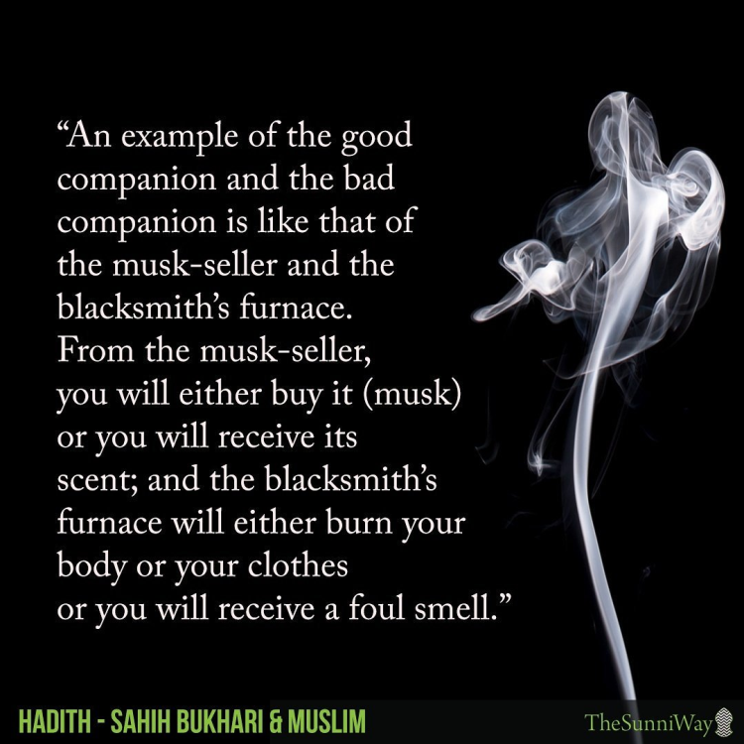

Environmental influence
To successfully address smoking behaviours in real world contexts, we must first understand the underlying dynamics of initiating, using, and quitting smoking with respect not only to individual-level characteristics of smokers, but also to their living and working environments ¹
Providing smokers with the motivation and skills to quit smoking cannot be effective if environments make it difficult or almost impossible to change their behaviour ²
“And (remember) the Day when the wrong-doer will bite on his hand, he will say: ‘Oh! Would that I had taken a path with the Messenger. Ah! Woe to me! Would that I had never taken so-and-so as a friend! He indeed led me astray from the Reminder (the Quran) after it had come to me.’” (Surah Al Furqan 25:27)
1. Brownson RC, Haire-Joshu D, Luke DA. Shaping the context of health: a review of environmental and policy approaches in the prevention of chronic diseases. Annu Rev Public Health. 2006; 27:341–370.
2. Calo WA, Krasny SE. Environmental determinants of smoking behaviors: The role of policy and environmental interventions in preventing smoking initiation and supporting cessation. Curr Cardiovasc Risk Rep. 2013 7(6): 446–452.

Slide 3

So…..
Positive/ encouraging environment is important - in behavior change- emphasize modern science & religiously!!!
Can you always move to a new land ?
Or a new neighbourhood?
Or new workplace?
Or get new friends..?
Or....get a new FAMILY?!
During Ramadan - an opportunity to weaken risky behaviours² (X)
Perceived barriers ¹
stress
enjoy smoking
addiction
social acceptability (X)
lack quit resources
pro-smoking living environments (X)
smoking cultural norms; (X)
Opportunity for easy initiation of smoking cessation
London-wide Ramadan campaign > 83% of Muslims in London showed positive attitude towards smoking cessation during Ramadan ³
Karachi it was reported that 91% of smokers attending a clinic - gave up smoking during the month of Ramadhan ⁴
A survey reported that 96.7% of Muslim smokers in Malaysia feel that stopping smoking during Ramadan is easier compared to other months.⁵
Let’s move?
In Malaysia …1 month ‘socially gazetted’ smoke free environment .. at least during ‘day time’
1. Sartaj A. Psycho-social behavior and health benefits of Islamic fasting during the month of Ramadan. J Community Med Health Edu. 2012; 2(9):2161-7
2. Tyman L, Bonevski B, Paul C, Bryant J. (2014) Perceived barriers to smoking cessation in selected vulnerable groups: a systematic review of qualitative and quantitative literature. BMJ 4:e006414. doi:10. 1136/bmjopen-2014-006414
3.Taket A, Koteccha M, Belling R. (2003) Evaluation of London-wide Ramadan campaign. South Bank University. London
4.Qidwai W. (2004) Barriers to smoking cessation: Results of a survey among family practice patients. Middle East Journal of Family Medicine 5:5
5. Abu Bakar AM, Lokman HJ, Amal MN, Anselm ST, Chan WH, Noraziah AR. et al. (2002) Religious belief in relation to smoking: a cross-sectional study among Muslim males in the month of Ramadan. Malaysian Journal of Medicine and Health Sciences 2(2):32-3

Slide 4
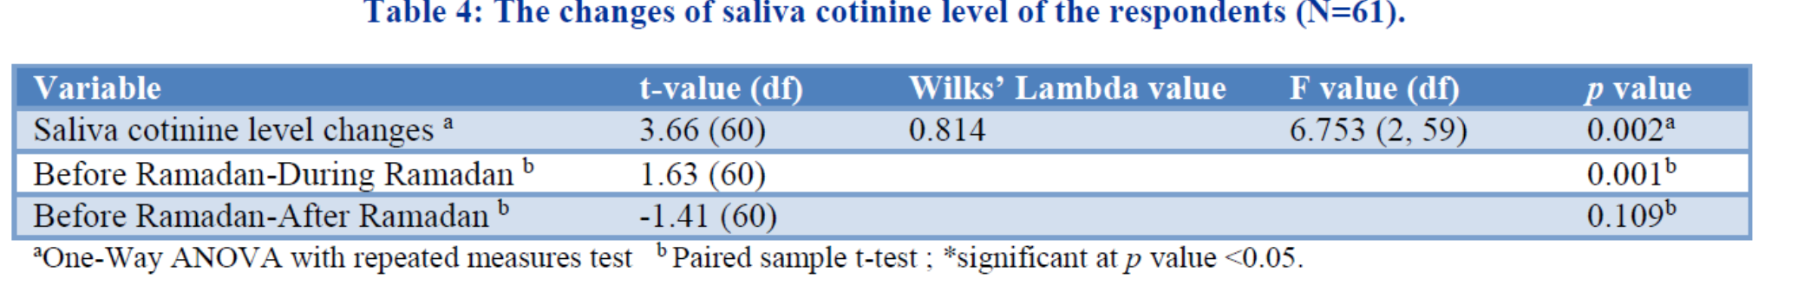
research
Without active intervention
Just Ramadan environment
Limitation
- exposed to Ramadan related ‘usual program/s’ such as national/organization program
Nuraisyah HZ, Suriani I, Rosliza AM. The changes in saliva cotinine during Ramadan among a group of Muslim smokers in Malaysia. International Journal of Community Medicine and Public Health.2017;4(2) 481-486. DOI: http://dx.doi.org/10.18203/2394-6040.ijcmph20170277

Slide 5
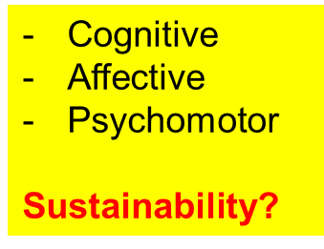
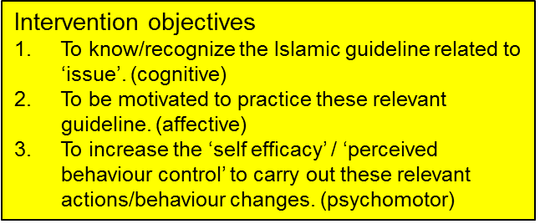
research
Methods: A quasi experiment was carried out. Two local authorities in Selangor state were selected. The intervention group received ‘walk through’ booklets -religious encouragements for smoking cessation. The outcomes monitored were FTND and saliva cotinine level-measured three times i.e. pre Ramadan (as the baseline), end of Ramadan (after the 21st Ramadan) and 1 month post Ramadan.
Table 1: The number of respondents according to smoking status before, during and after Ramadan and number of respondent in the intervention and control group
 | Intervention group (N=38) |  |  | Control group (N=61)
Smoking status | Before Ramadan | During Ramadan | After Ramadan | Before Ramadan | During Ramadan | After Ramadan
Stopped smoking |  | 3(7.9%) | 1 |  | 4(6.6%) | 5
Still smoking | 38 | 35 (92.1%) | 37 | 61 | 57(93.4%) | 56
Cigarettes only |  | 22+11* | 23+7* |  | 44+7* | 38+15*
Cigarettes + vape |  | 2 | 7 |  | 6 | 3
Total analysed | 38 | 38 | 38 | 61 | 61 | 61
The percentage of respondents who stopped smoking during Ramadan in this study is higher in the intervention group compared to the control group (7.9% vs 6.6%).
Table 2: The changes of saliva cotinine (ng/mL) from baseline (before Ramadan) to during and after Ramadan, within intervention and control group
ª Paired t test, *significant at P < 0.05
^{b} One way ANOVA,*significant at P < 0.05
 |  |  | Mean (SD) | Pair | P value ª | F | P value ^{b}
Saliva cotinine (ng/mL)
Intervention group
 |  | Before Ramadan | 93.73 (11.64) |  |  | 4.978(2) | 0.09
 |  | During Ramadan | 70.68 (32.24)
 |  | After Ramadan | 83.28 (25.72)
 |  |  |  | (1)-(2) | <0.001*
 |  |  |  | (1)-(3) | 0.025*
 |  |  |  | (2)-(3) | 0.014*
Control group
 |  | Before Ramadan | 81.99 (21.06) |  |  | 1.902(2) | 0.152
 |  | During Ramadan | 70.28 (31.19)
 |  | After Ramadan | 78.32 (32.82)
 |  |  |  | (1)-(2) | 0.001*
 |  |  |  | (1)-(3) | 0.223
 |  |  |  | (2)-(3) | 0.080
Results: The FTND score in the intervention group showed no significant change but the decreased saliva cotinine level in the intervention group was significant during Ramadan and it remained significant after Ramadan (p = <0.001, p = 0.025). Although the decreased saliva cotinine level during Ramadan in the control group was also significant (p = 0.001) it did not remain significant after Ramadan.
Suriani I, Hejar AR, Zainal Abidin E, Ahmad Sharul Nizam I, Sallehuddin AB, Zulkifley N.H, Ahmad Farhan AF. The effect of faith based smoking cessation intervention during Ramadan among Malay smokers Qatar Medical Journal 2016 16:1-10

Slide 6
Discussion
Both groups
  ↓saliva nicotine - ↓number of cigarette smoked during Ramadan
  Expected - opportunistic environment intervention
  failed to sustain - the environment has become pro smoking - enticed to smoke again to obtained pleasure from smoking and the smoking environment - experienced pre Ramadan
  Intervention group (additional religious component)
  revisit their conscience - general and related to their smoking behaviour
  +
  practical tips designed specifically to capitalise the Ramadan environment to stop smoking
  expected increase the intention -intention provokes and is the best predictor smoking behaviour change – better changes and sustainability
Strength
used biochemical marker cotinine saliva vs self-report (more objective)
intervention was not expensive no use of drug replacement regime not be costly.
Limitation
low initial respond rate
follow up -only 1 month post Ramadan
loss to follow up -threat to the research validity
there was an unexpected development of the phenomenal increased vaping trend in Malaysia during the study period

Slide 7

Conclusion & Recommendations
Despite the many limitations of this study, this finding could indicate the positive effect of using of this culturally-competent intervention to encourage smokers to start smoking cessation during Ramadan.
  Health care provider should continue the effort to encourage Muslim smokers to start smoking cessation during Ramadan
  At clinical settings (either in clinics or hospitals) physician attending to a patient who is a smoker, just before Ramadan could strongly suggest to the patient to use the opportunity of Ramadan environment to start stop smoking
However, additional components of the intervention must be developed to help smokers who had stopped smoking during Ramadan from relapsing.,
  Factor such as social support could help in the maintenance phase
ABSOLUTE SMOKE FREE HOME DURING RAMADAN
AND SHAWAL!!!

