Slide 1
Secondhand Smoke Campaigns and Initiatives
Irene Stewart
Health Improvement Senior – Tobacco
Glasgow City Health and Social Care Partnership
NHS Greater Glasgow and Clyde
irene.stewart@ggc.scot.nhs.uk
8 May 2018

Slide 2

Exposure to Secondhand Smoke
To reduce the prevalence of children’s exposure to tobacco smoke to 6% by 2020
*Scottish government 2014
6% of children (age 0-12) are reported to be exposed to smoke at home
          *Scottish Health Survey 2015
8 May 2018

Slide 3


How are Children Exposed to SHS in our area?
Home
  44% live with a smoker
  25% live with someone who smokes inside the home and/or in the car
  67% were ever exposed to second hand smoke
Car
8 May 2018
(NHSGGC 2014, Glasgow School Survey (S1 to S6 pupils)

Slide 4
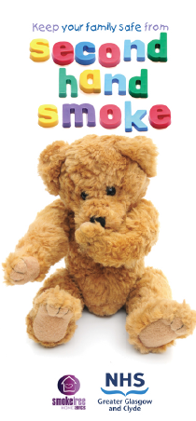

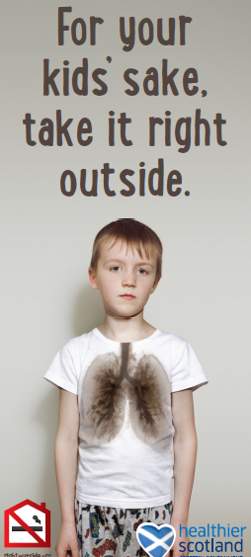
Campaigns and Initiatives
GGC Campaign
Jenny and the Bear
National Campaign
8 May 2018

Slide 5
Jenny and the Bear Timeline
  August-December 2017 January 2018 February 2018 March-April 2018
Receive invitation to register for programme in August 2017. Cut off for registration is 22/12/17
Receive resource pack
Deliver JTB activity to your class - watch video, name the teddy and submit name by 28/02/18
Winners will be notified and participation certificates sent out between April – June 2018
A link to a video of the JTB story to watch in class
Individual JTB booklets for pupils to take home- pupils to complete colouring page at home
A competition name entry form (to submit the class teddy name)
A pre-paid envelope to submit your name entry
(All included in lesson plan – other activities)
Winning class receives:
Certificate/SHS message
Mini bears
Bear mascot for class
8 May 2018

Slide 6
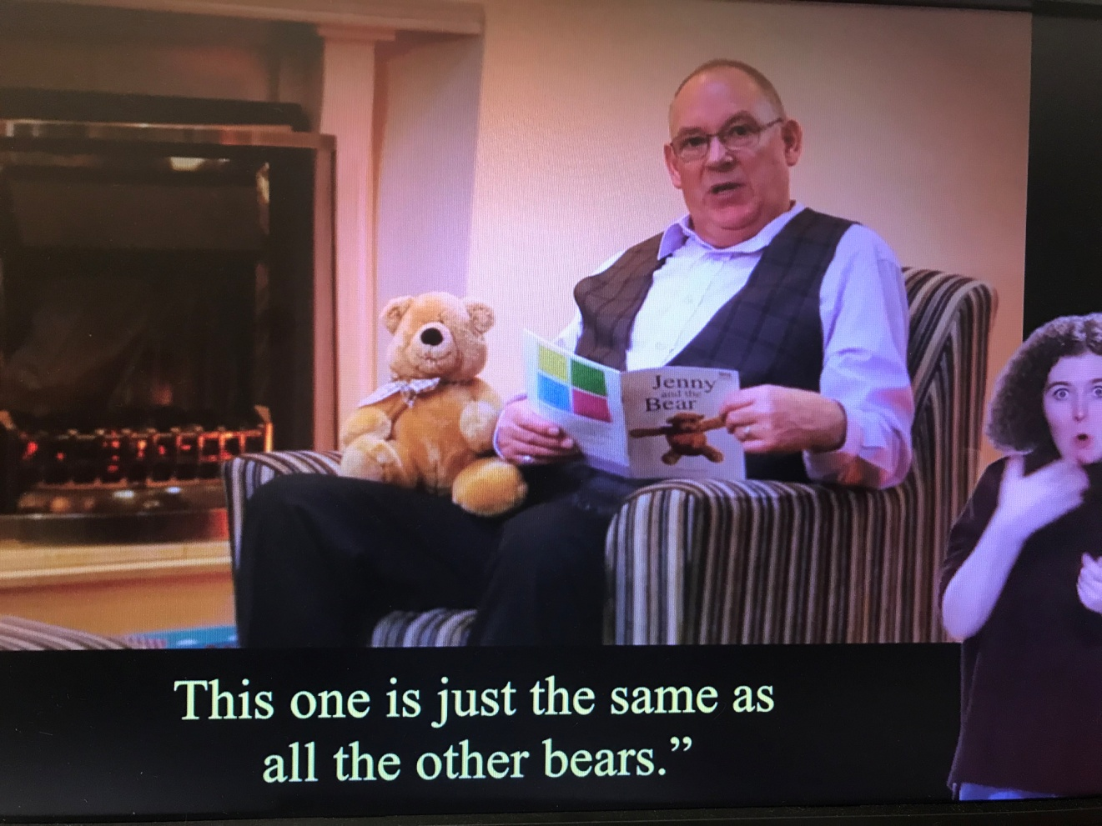
Jenny & the Bear
  You tube video https://
  www.youtube.com/
  watch?v=24RFDGeNnGU
  with sub-titles and
  British Sign Language
8 May 2018

Slide 7
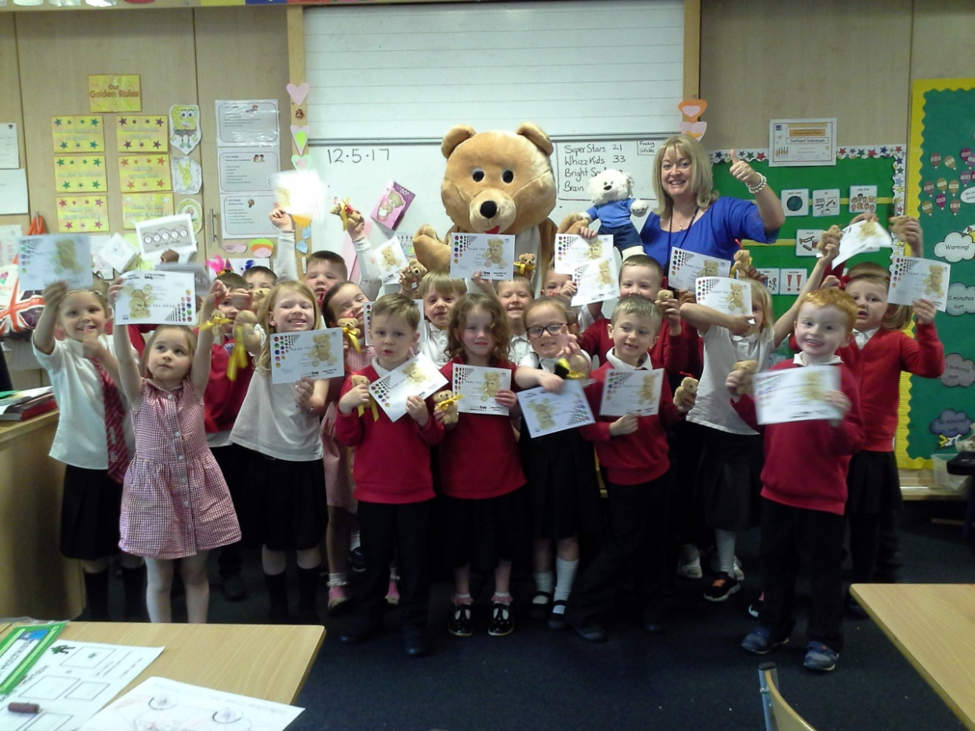
A winning class : 2017
8 May 2018

Slide 8
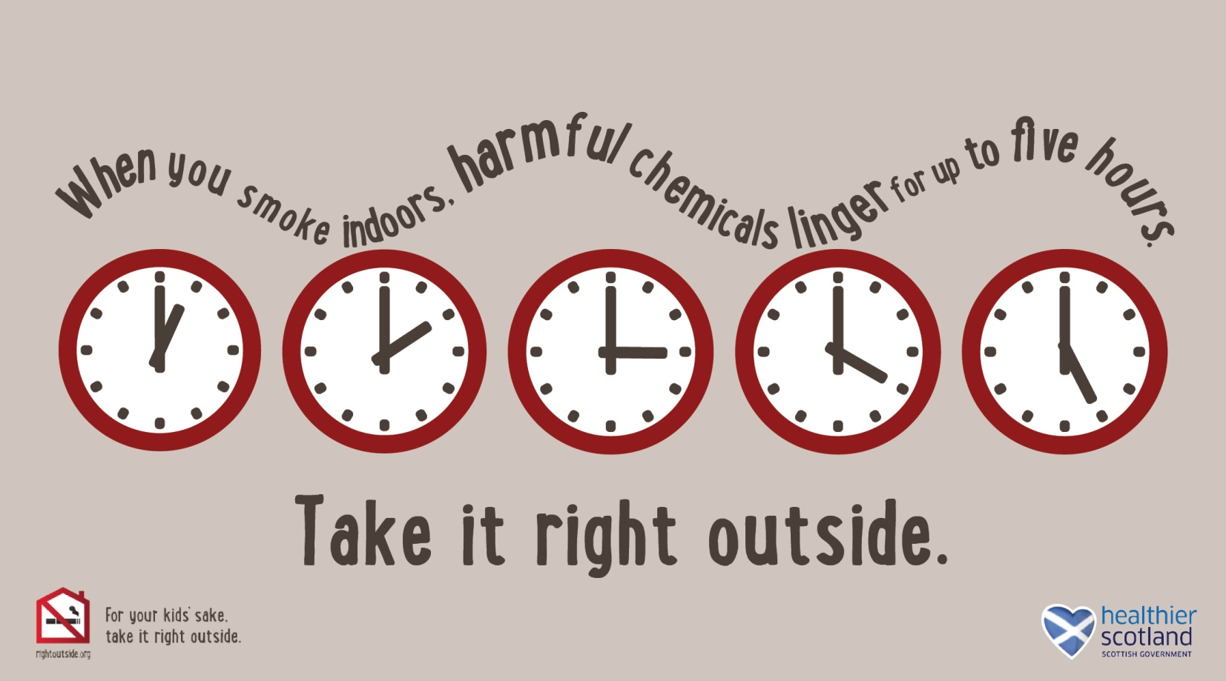
National Campaign : Take it Right Outside
www.rightoutside.org
8 May 2018

Slide 9
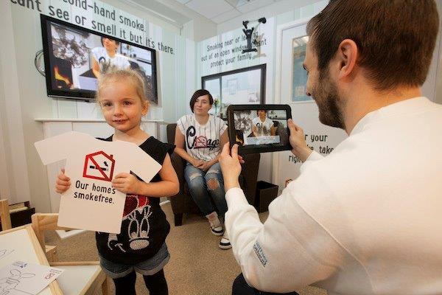
National Campaign : Take it Right Outside
8 May 2018

Slide 10

Any questions?
8 May 2018

