Slide 1
Measuring for change: Air Quality Feed-Back to Reduce SHS Exposure in Homes
(TackSHS Work Package 4)
Research Team: Sean Semple (PI),
Rachel O’Donnell
Ruaraidh Dobson

Slide 2
Measuring for change aims
To test the feasibility and effectiveness of a smoke-free homes intervention that combines air quality feedback with rapid, remote feedback in deprived populations in four European countries (Scotland, Italy, Greece and Spain)
To test the feasibility of using internet-connected air quality monitors to record air quality information and upload it for use as part of an educational intervention on the effects of smoking on household air quality

Slide 3
Study design
Measurements for 30 days
Primary outcome is PM_{2.5} concentration on day 24-30 compared to baseline (day 1-7)
Two household visits (day 1 and 30)
Daily text messages from day 8-23
3 emails (day 8 and 22)
2 phone calls (day 9 and 23)

Slide 4
Participant SMS feedback
The second-hand smoke level in your home was 121 over the last 24 hours. This is lower than the average over the previous seven days, well done! This is higher than a smoke-free home in Edinburgh. Why not text visitors in advance to let them know your home is smoke-free?
Daily SMS to participant providing
Average levels from previous 24h
How does that compare to last 7 days
Is it higher or about the same as a typical smoke-free home in their area
Plus some follow-up advice/information

Slide 5
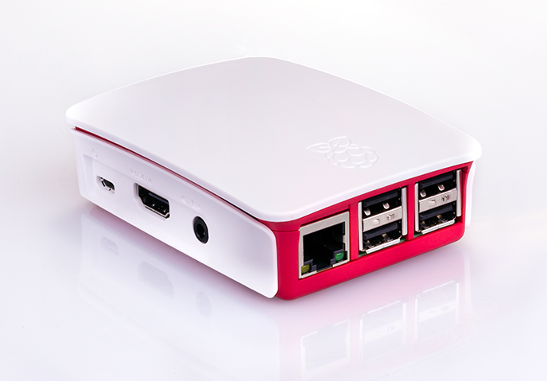
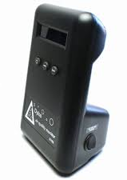
Monitoring using Dylos
+ Raspberry Pi
New air quality monitoring technology developing very quickly
Dylos DC1700 provides accurate laser particle counts
Combined with Raspberry Pi mini-computer and mobile internet access to send data to server
Provides ability to provide study participants with near real-time feedback

Slide 6
Feedback generation
Partially automated text feedback with texts generated by computer, approved/altered by a researcher, then sent by software
Email feedback is generated automatically using visualisations below
Records of this feedback are stored on a secure network drive and displayed when a researcher is contacting a participant

Slide 7
Work so far
Control software developed and functioning
Raspberry Pi-based Dylos communication system developed and functioning
Ethical approval obtained in all four countries
29 participants recruited in Scotland
Of those 29 participants:
12 have completed the 30 day intervention
8 are currently taking part
1 is awaiting installation
8 disengaged after the first stage of recruitment

