Slide 1
Using air quality monitors to measure second-hand smoke in homes
Ruaraidh Dobson (r.p.dobson@stir.ac.uk) PhD student, Institute for Social Marketing

Slide 2
Two minute introduction to monitoring second-hand smoke (SHS)
SHS is a complex mix of gases and aerosolised particles
More than 4,000 chemical components!
So how do we identify its presence?
Several different options:
PM_{2.5}, nicotine, benzene, PAHs
We use PM because cheap optical particle counters can monitor concentrations/particle numbers over time
Useful for intervention studies
But other studies might use different approaches

Slide 3
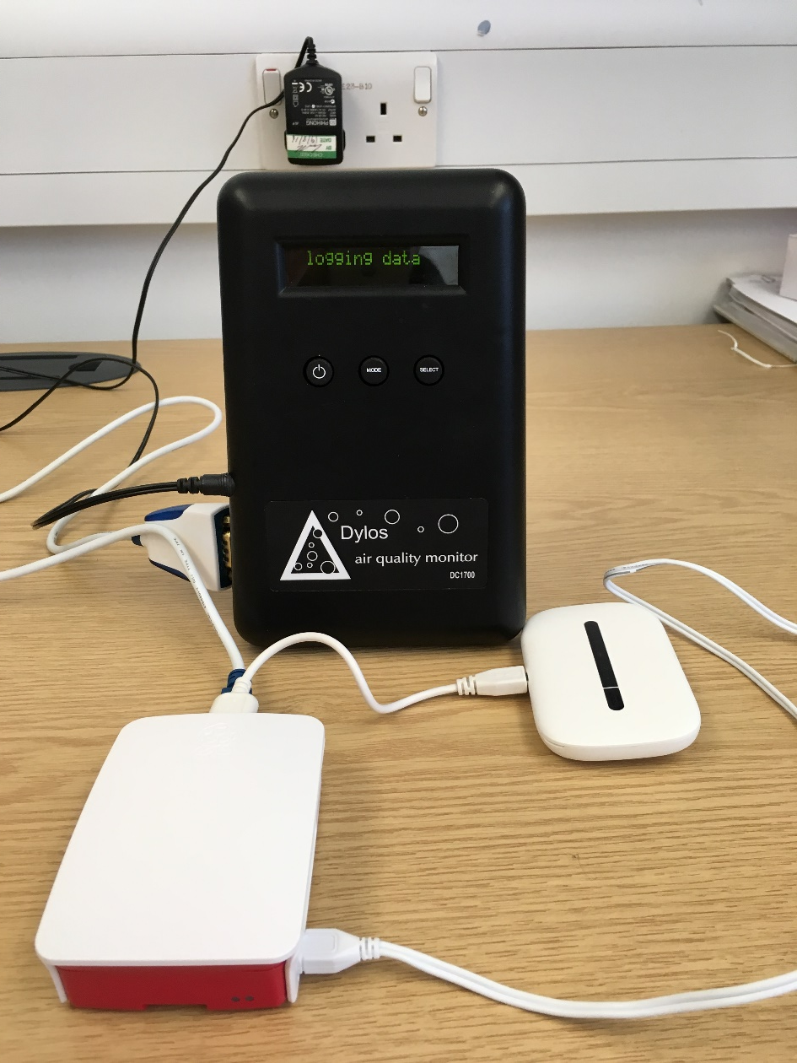
Our approach in TackSHS
Remote PM_{2.5} monitoring using Dylos DC1700 monitors + Raspberry Pi mini-computers + GSM internet access
The RAPID system – a “homespun” version of a remote monitor with reliable PM_{2.5} sensing capabilities

Slide 4
Tackle (application on a Windows PC)
RAPID monitor
(Dylos + Rpi)
RAPID Server (stores data on PythonAnywhere)
Available via browser (web gateway)
PM data
RAPID monitor
(Dylos + Rpi)
Available via REST API
Participants’ homes
Mobile internet
The cloud
The internet
Research facilities

Slide 5
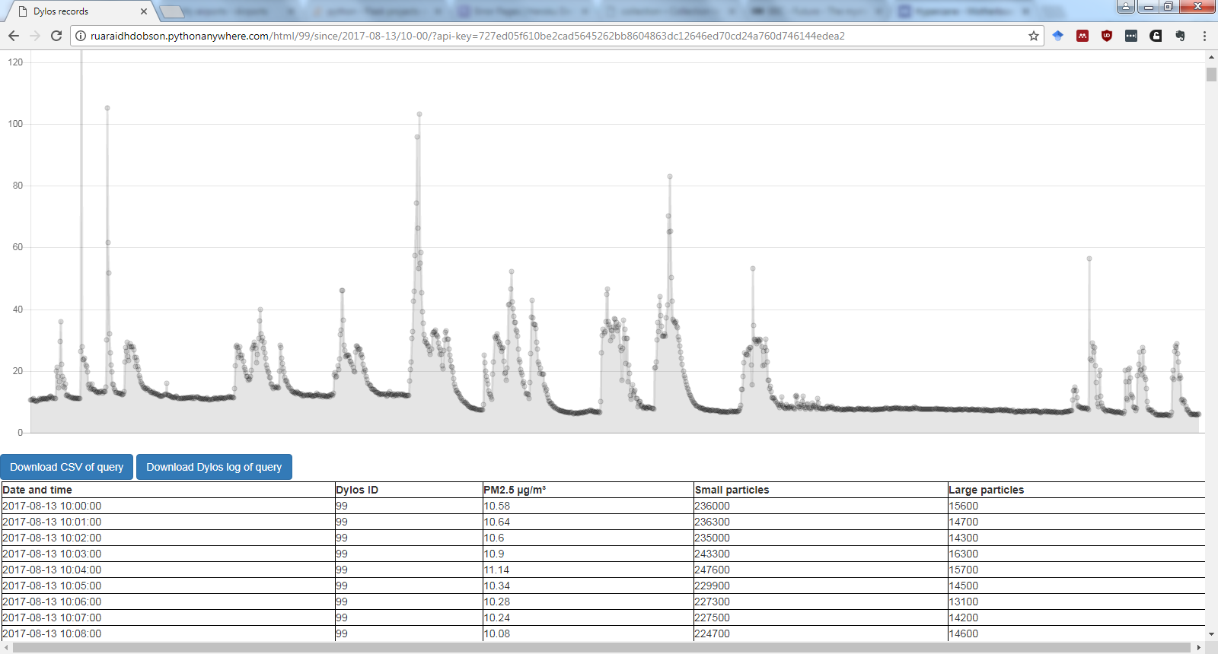

Slide 6
Why did we take this approach?
Wanted a simple, understandable way to link SHS to health harm (PM_{2.5} air quality index provides this)
Needed a cheap solution!
Wanted to work with technology we were comfortable with
Didn’t need to be 100% specific for SHS, just enough to show participants a clear connection between smoking indoors and poor air quality
Wanted to deliver near immediate feedback remotely (daily SMS messages)

Slide 7
Planning SHS monitoring studies
What environments can we measure?
What SHS proxy do we want to measure?
How specific/selective do we need to be?
What timeframe do we want to measure?
What do we want to know about the environment?
What do we want to know about exposure?
What resolution do we need?
Do we want to quantify harm to people exposed?

Slide 8
What else do we need to take into account?
Humidity
Particle counters can be less reliable at >70% relative humidity
Location & weather
Other sources of pollutants
E.g. cooking or biomass smoke for PM
Monitor failure/human error
It happens – will there be power/an internet connection for the monitor? What if there isn’t?

Slide 9
Confirming the presence of SHS using a particle counter
Although PM_{2.5} is not specific to SHS, it’s a good proxy and easy to detect reliably
We’ve used an algorithm based on the ratio of PM_{2.5} to PM₁₀ over time to reliably detect the presence of SHS in a home
Can’t yet use this information to define exactly when SHS is present, but new sensors with additional size bins could let us
This has been tested in Scotland and Israel
I’d love to work with you to test it in Malaysia or other countries!
Paper under review with Environmental Research

Slide 10
Get in touch
I’d love to collaborate on your SHS exposure assessment studies!
Ruaraidh Dobson
Email: r.p.dobson@stir.ac.uk

