Slide 1
Children’s Exposure to SHS in Malaysia
Prof. Dr. Zailina Hashim
Dept of Environmental and Occupational Health
Faculty of Medicine and Health Sciences
Universiti Putra Malaysia

Slide 2
Sources of respirable particulate matter at home in Malaysia (indoor air)
SHS from cigarettes smoke (urban and rural)
Motor vehicles from traffic (urban)
Wood stove (rural areas)
Mosquito coil burning (urban and rural)

Slide 3
Control of Tobacco Product Regulations and places where smoking are prohibited in Malaysia.
2004 | Control of Tobacco product Regulation: Ban on tobacco advertisement, sponsorship and free tobacco
2005 | FCTC Ratification: Malaysia become party to WHO-FCTC
2007 | Exercise duty increased 25%
2008 | Amendment to regulation
2009 | Established the minimum price of RM7.00/pack of 20 & no promotion price
2010 | Amendment of Regulations and ban on cigarette package with 14 sticks
2011 | Smoke free in all air-conditioned workplace & Melaka smoke free initiatives
2012 | Amendment of Regulation
2013 | Amendment of Regulation

Slide 4
Table 1: Factors that influenced micronuclei frequency in study children
Variable | b(95% CI) | t | p | r² | b(95% CI) | t | p
Magnetic field level | 2.475 (-3.783,8.734) | 0.787 | 0.434 | 0.008 | - | - | -
Gender | 0.082 (-3.296,3.459) | 0.048 | 0.962 | 0.000 | - | - | -
BMI | -0.139 (-0.529,0.251) | -0.709 | 0.480 | 0.006 | - | - | -
Parent’s education | -0.323 (-1.494,0.848) | -0.550 | 0.584 | 0.004 | - | - | -
Second-hand smoke | -3.291 (-6.555,-0.027) | -2.008 | 0.048* | 0.050 | -3.757 (-7.487,-0.028) | -2.017 | 0.048*
Length of residency | -0.152 (-2.216,2.520) | 0.128 | 0.898 | 0.000 | - | - | -
HVPL surrounding area | -2.734 (-6.688,1.219) | -1.380 | 0.172 | 0.027 | - | - | -
Total number of household appliances | -0.206 (-0.246,0.658) | -0.907 | 0.367 | 0.011 | - | - | -

Slide 5
Weili Liu Zhang J. Jamal HH. Juliana J. Zailina H. and Goldstein BD. (2003). Mosquito coil emissions and health implications. Environmental Health Perspectives. 111: (12) 1454-60.
The ﬁndings suggest that exposure to the smoke of mosquito coils similar to the tested ones can pose signiﬁcant acute and chronic health risks.
For example, burning one mosquito coil would release the same amount of PM2.5 mass as burning 75–137 cigarettes.
The emission of formaldehyde from burning one coil can be as high as that released from burning 51 cigarettes

Slide 6
Zulkifli, A., Abidin, N. Z., Abidin, E. Z., Hashim, Z., Rahman, A. A., Rasdi, I., Semple, S. (2014). Implementation of smoke-free legislation in Malaysia: are adolescents protected from respiratory health effects? Asian Pac J Cancer Prev, 15(12), 4815–4821
SHS exposure in public transport was linked to increased risk for wheeze ( AOR 16.6; 95% CI, 2.69-101.7) and current wheezing (AOR 24.6; 95%CI, 3.53-171.8).
Adolescents continue to be exposed to SHS in a range of public venues in both comprehensive and partial-SFL states.
Respiratory symptoms are common SHS exposure on public transportation.
Non-compliance with SFL appears to be frequent in many venues across Malaysia and enforcement should be given priority in order to reduce exposure

Slide 7
N. Zainol Abidin,* A. Zulkifli,* E. Zainal Abidin,* I. Rasdi,* S. N. Syed Ismail,* A. Abd Rahman,† Z. Hashim,* S. Semple *(2014)Knowledge, attitude and perception of second-hand smoke and factors promoting smoking in Malaysian adolescents ‡ Int J Tuberc Lung Dis 18(7):856–861
Adolescents with limited ETS exposure who lived in a state with complete SFL were less likely to attempt smoking
Compared to those exposed more regularly to ETS and living in a state with partial SFL.
Preventing adolescents from becoming smokers is the key to reducing national prevalence rates in smoking

Slide 8
Abidin, E. Z., Hashim, Z., & Semple, S. (2013). Secondhand smoke in public spaces: How effective has partial smoke-free legislation been in Malaysia? Asian Pacific Journal of Cancer Prevention, 14, 6845–6850.
Findings showed:
Second-Hand Smoke (SHS) reported in most venues and high level of PM2.5 (33.4 µg/m3; more than the WHO limit of 25 µg/m3 for a 24 hours exposure)
1/3 venues were listed as smoking prohibited places by law while 2/3 venues were mechanically-ventilated spaces exposed to the outdoor air with high public occupancy.
Despite 8 years of SFL implementation, poor compliance especially in entertainment centres and Internet cafés.

Slide 9
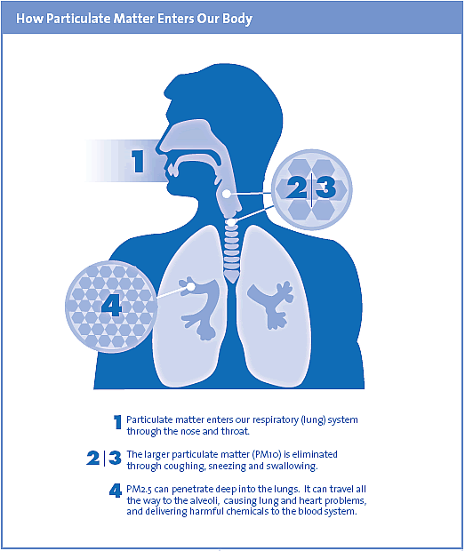
Health Effects on Passive Smoker
Both short term and long term effects
Short-term
  Decreased lung function
  increased respiratory symptoms
  Cardiac arrhythmias
  Heart attacks
  Premature death
Long-term
  Decreased lung function
  Chronic bronchitis
  Lung cancer
  Premature death
Some populations more susceptible than others
  People with heart/lung disease, elderly, and children
Image source: bcairquality.ca

Slide 10
Increasing evidence of cardiovascular effects
Until the mid 1990s, most research focused on the association of PM exposure with respiratory disease. Since then, there has been growing evidence of cardiovascular health effects from PM.
Source: Pope and Dockery, JAWMA, 2006

Slide 11
Quantified Mortality Risk from Particulate Matter Exposure
(Pope III et al. 2002)
Pope III et al. (2002) studied long-term exposure
  Sample size of 500,000 adults over 30 years old from all 50 US states
  Corrected for age, sex, race, weight, height, smoking history, alcohol use, occupational exposures, diet, education, and marital status
  Assessed mortality from three causes: all-cause, cardiopulmonary, and lung cancer compared with PM exposure
Findings
PM_{2.5}
All-cause
Cardiopulmonary
Lung Cancer
10 μg/L
4%
6%
8%
10 μg/L
Pope III, C. A., Burnett, R. T.,…& Thurston, G. D. (2002). Lung cancer, cardiopulmonary mortality, and long-term exposure to fine particulate air pollution. Jama, 287(9), 1132-1141.

Slide 12
THANK YOU

