Slide 1
Using the AFRESH software
Ruaraidh Dobson
University of Aberdeen
Ruaraidh.Dobson@abdn.ac.uk

Slide 2
You will need…
A laptop running Windows XP or later
A Dylos DC1700
A USB Serial converter cable
This will come with a CD containing a piece of software called a “driver”. You need to install it before you do anything else.
The AFRESH software
You can get this from http://smokefreehomes.network/AFRESH
You’ll need to be able to install software on your computer. If in doubt, ask your IT department.
Be aware that AFRESH is still in development at the moment, so will be a few bugs. If you notice any, please email me at Ruaraidh.Dobson@abdn.ac.uk

Slide 3
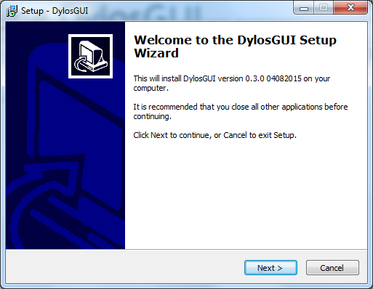
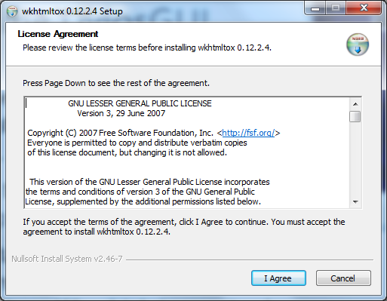
Installing AFRESH
You’ll need to have an administrator install the software for you.
Launch the installer and follow the steps.
The installer will also install a programme called “wkhtmltox”, which is required to make PDF reports.

Slide 4
First of all…
Make sure that the Dylos is switched on, showing “Logging Data” on the front
Then, plug the Dylos into your laptop or PC with your converter cable

Slide 5
Now open AFRESH
AFRESH
There should be a start menu icon that looks like this:
The software should start up.
You’ll see a splashscreen like the below, and then…
AFRESH

Slide 6
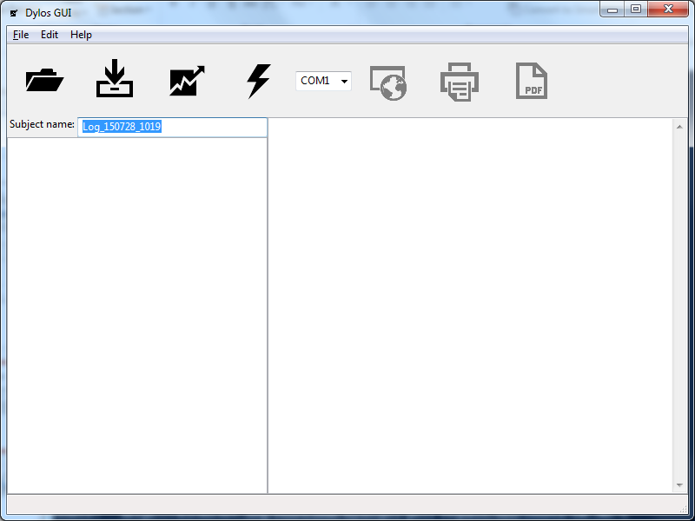
Download a log from a Dylos connected to your computer
Make a report
Open a log on your computer
Quick start – download a log and produce a report in one go
View the current report in your browser
Print the current report
Name the log and report
View a PDF of the report
Open/downloaded log displays here
Choose the port your Dylos is attached to
Report displayed here
DON’T PANIC!
It looks more complicated than it is.

Slide 7
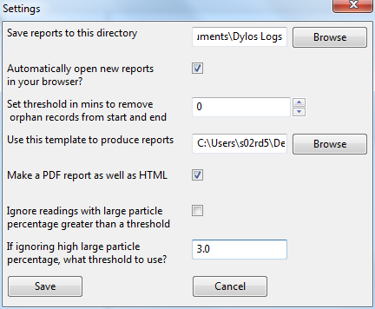
Settings
Choose where to save reports. By default, this will be My Documents\Dylos Logs
If there are a few minutes of data from a different day at the start or end of a log, DylosGUI ignores them as they are usually from the few minutes when data’s being downloaded from the Dylos. It’s simplest to leave this at 0.
If this is ticked, your web browser will automatically open new reports when they are generated (recommended)
Choose a different template for producing air quality reports.
Make a PDF file containing the report (recommended). That makes it a lot easier to send the report from one computer to another. By default, PDF files are stored in My Documents\Dylos Logs
This is an experimental setting – make sure it’s not ticked.

Slide 8
Downloading a log
Type the name you want to give the report here, or it will be assigned a name based on the date and time of download
Click here to download
Make sure the box on the right of the toolbar says “COM<number>”
If is doesn’t, take the Dylos out and plug it in again. Make sure it’s on!
If you keep getting “No Dylos Detected”, make sure you have your cable’s drivers installed.
Be aware that downloading a log takes a few minutes. If you’re downloading a full five days, best make a cup of tea.

Slide 9
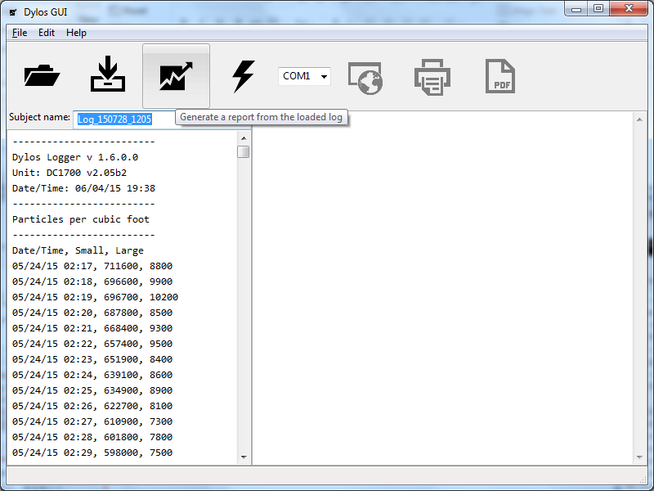
Generating a standard report
Click the graph icon to generate a report once you’ve downloaded a log
This will take just a minute

Slide 10
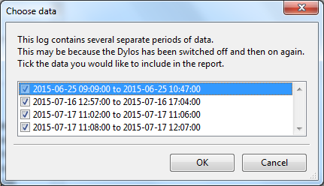
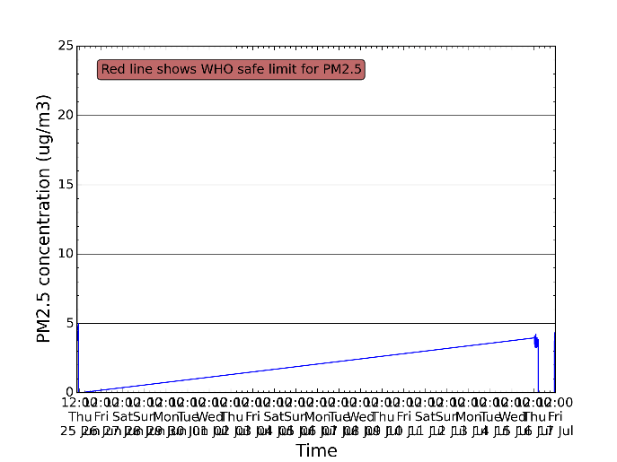
If your Dylos was switched off and on…
…you might see this screen.
You may wish only to choose the largest sections of data, otherwise the graph will be difficult to interpret (and not very useful, as below)

Slide 11
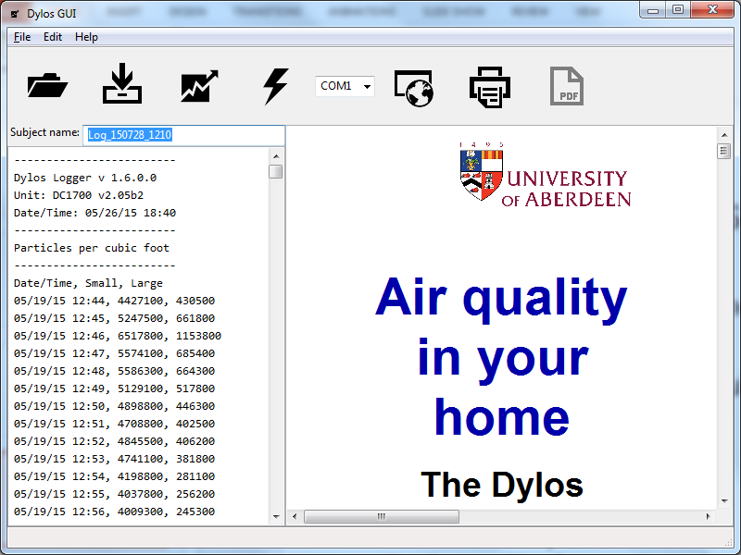
When the report is generated
You can see the report in the right hand panel
If you haven’t changed the settings, it should also open automatically in Internet Explorer, Firefox or Google Chrome
The report can be skimmed in your browser, but should be printed from a PDF

Slide 12
Opening a PDF
PDF files are easy to email and always look (and print) the same on different computers.
Click on the PDF button to open it when your report has been generated.
Note – you’ll need Adobe Reader or similar software to open PDFs. This usually comes with your computer, or you can download it for free.

Slide 13
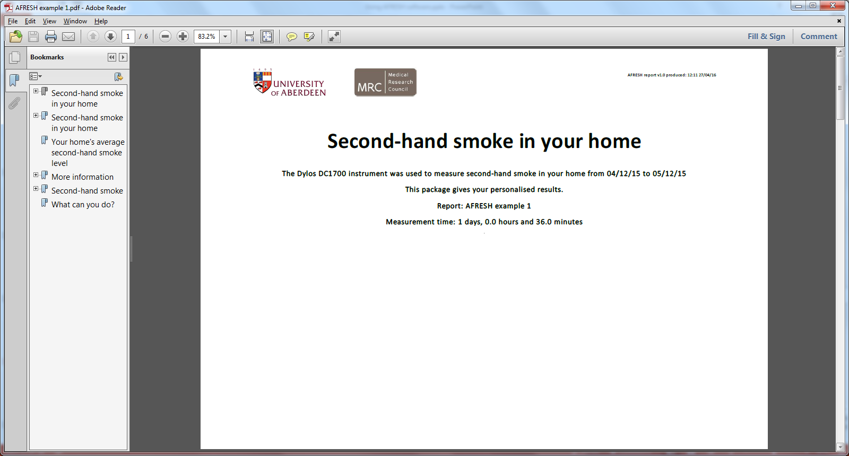
Printing your report
Open the PDF
Then go to File and click Print (or press Ctrl-P)
It’s best to print in colour if you can

Slide 14
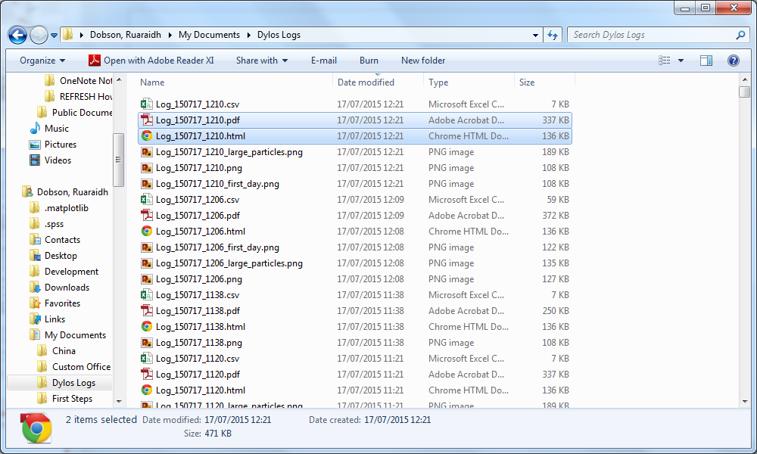
Finding your reports
By default, logs can be found in My Documents\Dylos Logs
All the files have the name you gave the log under “Subject Name”, or a default name based on the date and time
There are lots of files, but the only ones you need to worry about are those ending in “PDF” and “HTML”

Slide 15
Making a comparison report
When the Dylos has been in a home for a second time, we want to compare the two results using a comparison report
This shows if the client has made an improvement and whether the home is now safe

Slide 16
Comparing two logs
Choose the earlier log using this button
Choose the later log using this button
Then click Compare to produce the report

Slide 17
Printing the comparison report
This is just like printing a standard report
Press the Open PDF button and print from there

Slide 18
If you find a bug
Email me at ruaraidh.dobon@abdn.ac.uk
Include a full description of what you were doing and what happened.
If you can, include a screenshot with your email (press “prt scn” at the top right of your keyboard, then paste into an email)
Then, attach the following files to the email:
C:\Program Files\DylosGUI\debug_log.txt
C:\Program Files\DylosGUI\settings.ini
If you can’t find them, look under C:\Program Files (x86)\DylosGUI
Thank you!

